Slide 1
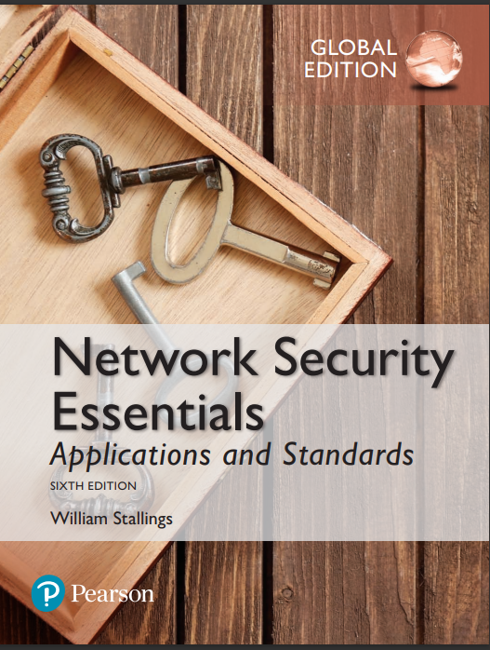
Information Security
By Dr. Taghinezhad
Mail: a0taghinezhad@gmail.com
Website: ataghinezhad.github.io
Notes:
Lecture slides prepared for “Network Security Essentials”, 5/e, by William Stallings, Chapter 1 – “Introduction”.

Slide 2
About This Course
Class
Project
Exam
Grading
2
4
14
20

Slide 3
References
Download PDFS
اصول امنیت شبکه
Network Security Essentials Applications
https://ataghinezhad.github.io/networkSecurity.html

Slide 4
project assignments that covers a broad range of topics from the text
■■ Hacking project: This exercise is designed to illuminate the key issues in intrusion detection and prevention.
■■ Research projects: A series of research assignments that instruct the student to research a particular topic on the Internet and write a report.
■■ Programming projects: A series of programming projects that cover a broad range of topics and that can be implemented in any suitable language on any platform.
■■ Practical security assessments: A set of exercises to examine current infrastructure and practices of an existing organization.
■■ Firewall projects: A portable network firewall visualization simulator is provided, together with exercises for teaching the fundamentals of firewalls.

Slide 5
Chapter 1
Introduction
Notes:
This chapter provides a general overview of the subject matter that structures
the material in the remainder of the book. We begin with a general discussion of network
security services and mechanisms and of the types of attacks they are designed
for. Then we develop a general overall model within which the security services and
mechanisms can be viewed.

Slide 6
Computer Security Concepts
Before the widespread use of data processing equipment, the security of information valuable to an organization was provided primarily by physical and administrative means
1) rugged filing cabinets with a combination lock for storing sensitive documents.
2) personnel screening procedures used during the hiring process. (گزینش)
With the introduction of the computer, the need for automated tools for protecting files and other information stored on the computer became evident
Another major change that affected security is the introduction of distributed systems and the use of networks and communications facilities for carrying data between terminal user and computer and between computer and computer
Notes:
The requirements of information security within an organization have undergone two major changes in the last several decades. Before the widespread use of data processing
equipment, the security of information felt to be valuable to an organization was provided primarily by physical and administrative means. An example of the former
is the use of rugged filing cabinets with a combination lock for storing sensitive documents. An example of the latter is personnel screening procedures used during the
hiring process.
With the introduction of the computer, the need for automated tools for protecting files and other information stored on the computer became evident. This is
especially the case for a shared system, such as a time-sharing system, and the need is even more acute for systems that can be accessed over a public telephone network,
data network, or the Internet. The generic name for the collection of tools designed to protect data and to thwart hackers is computer security .
The second major change that affected security is the introduction of distributed systems and the use of networks and communications facilities
for carrying data between terminal user and computer and between computer and computer. Network security measures are needed to protect data during their
transmission. In fact, the term network security is somewhat misleading, because virtually all business, government, and academic organizations interconnect
their data processing equipment with a collection of interconnected networks. Such a collection is often referred to as an internet, and the term internet
security is used.
There are no clear boundaries between these two forms of security. For
example, a computer virus may be introduced into a system physically when it
arrives on a flash drive or an optical disk and is subsequently loaded onto a computer.
Viruses may also arrive over an internet. In either case, once the virus is resident
on a computer system, internal computer security tools are needed to detect
and recover from the virus.
This book focuses on internet security, which consists of measures to deter,
prevent, detect, and correct security violations that involve the transmission of
information.

Slide 7
Computer Security Concepts
Computer security
The generic name for the collection of tools designed to protect data and to thwart hackers
internet security (lower case “i” refers to any interconnected collection of network)
Consists of measures to deter, prevent, detect, and correct security violations that involve the transmission of information
Notes:
Thwart: خنثی کردن
Deter بازداری

Slide 8
What areas are covered in this book
Consider the following examples of security violations:
1. User A transmits a file to user B. The file contains sensitive information (e.g., payroll records) that is to be protected from disclosure. User C, who is not authorized to read the file, is able to monitor the transmission and capture a copy of the file during its transmission.
2. A network manager, D, transmits a message to a computer, E, under its management. The message instructs computer E to update an authorization file to include the identities of a number of new users who are to be given access to that computer. User F intercepts the message, alters its contents to add or delete entries, and then forwards the message to E, which accepts the message as coming from manager D and updates its authorization file accordingly.
3. Rather than intercept a message, user F constructs its own message with the desired entries and transmits that message to E as if it had come from manager D. Computer E accepts the message as coming from manager D and updates its authorization file accordingly.
Notes:
Payroll: لیست حقوق

Slide 9
What areas are covered in this book
Consider the following examples of security violations:
4. An employee is fired without warning. The personnel manager sends a message to a server system to invalidate the employee’s account. When the invalidation is accomplished, the server is to post a notice to the employee’s file as confirmation of the action. The employee is able to intercept the message and delay it long enough to make a final access to the server to retrieve sensitive information. The message is then forwarded, the action taken, and the confirmation posted. The employee’s action may go unnoticed for some considerable time.
5. A message is sent from a customer to a stockbroker with instructions for various transactions. Subsequently, the investments lose value and the customer denies sending the message
Notes:
Payroll: لیست حقوق

Slide 10
Computer Security
The NIST(National Institute of Standards and Technology in USA) Computer Security Handbook defines the term computer security as:
“The protection afforded to an automated information system in order to attain the applicable objectives of preserving the integrity(یکپارچگی), availability(دسترس پذیری), and confidentiality(محرمانگی) of information system resources (includes hardware, software, firmware, information/data, and telecommunications)”

Slide 11
Computer Security Objectives
Confidentiality
Data confidentiality(محرمانگی داده)
Assures that private or confidential information is not made available or disclosed to unauthorized individuals
Privacy (حریم خصوصی)
Assures that individuals control or influence what information related to them may be collected and stored and by whom and to whom that information may be disclosed
Integrity
Availability
Assures that systems work promptly and service is not denied to authorized users
Assures that a system performs its intended function in an unimpaired manner, free from deliberate or inadvertent unauthorized manipulation of the system
System integrity
Assures that information and programs are changed only in a specified and authorized manner
Data integrity
Notes:
Privacy: Assures that individuals control or influence what information
related to them may be collected and stored and by whom and to whom
that information may be disclosed.
•Integrity: This term covers two related concepts:
Data integrity: Assures that information and programs are changed only in
a specified and authorized manner.
System integrity: Assures that a system performs its intended function in
an unimpaired manner, free from deliberate or inadvertent unauthorized
manipulation of the system.
• Availability: Assures that systems work promptly and service is not denied to
authorized users.

Slide 12
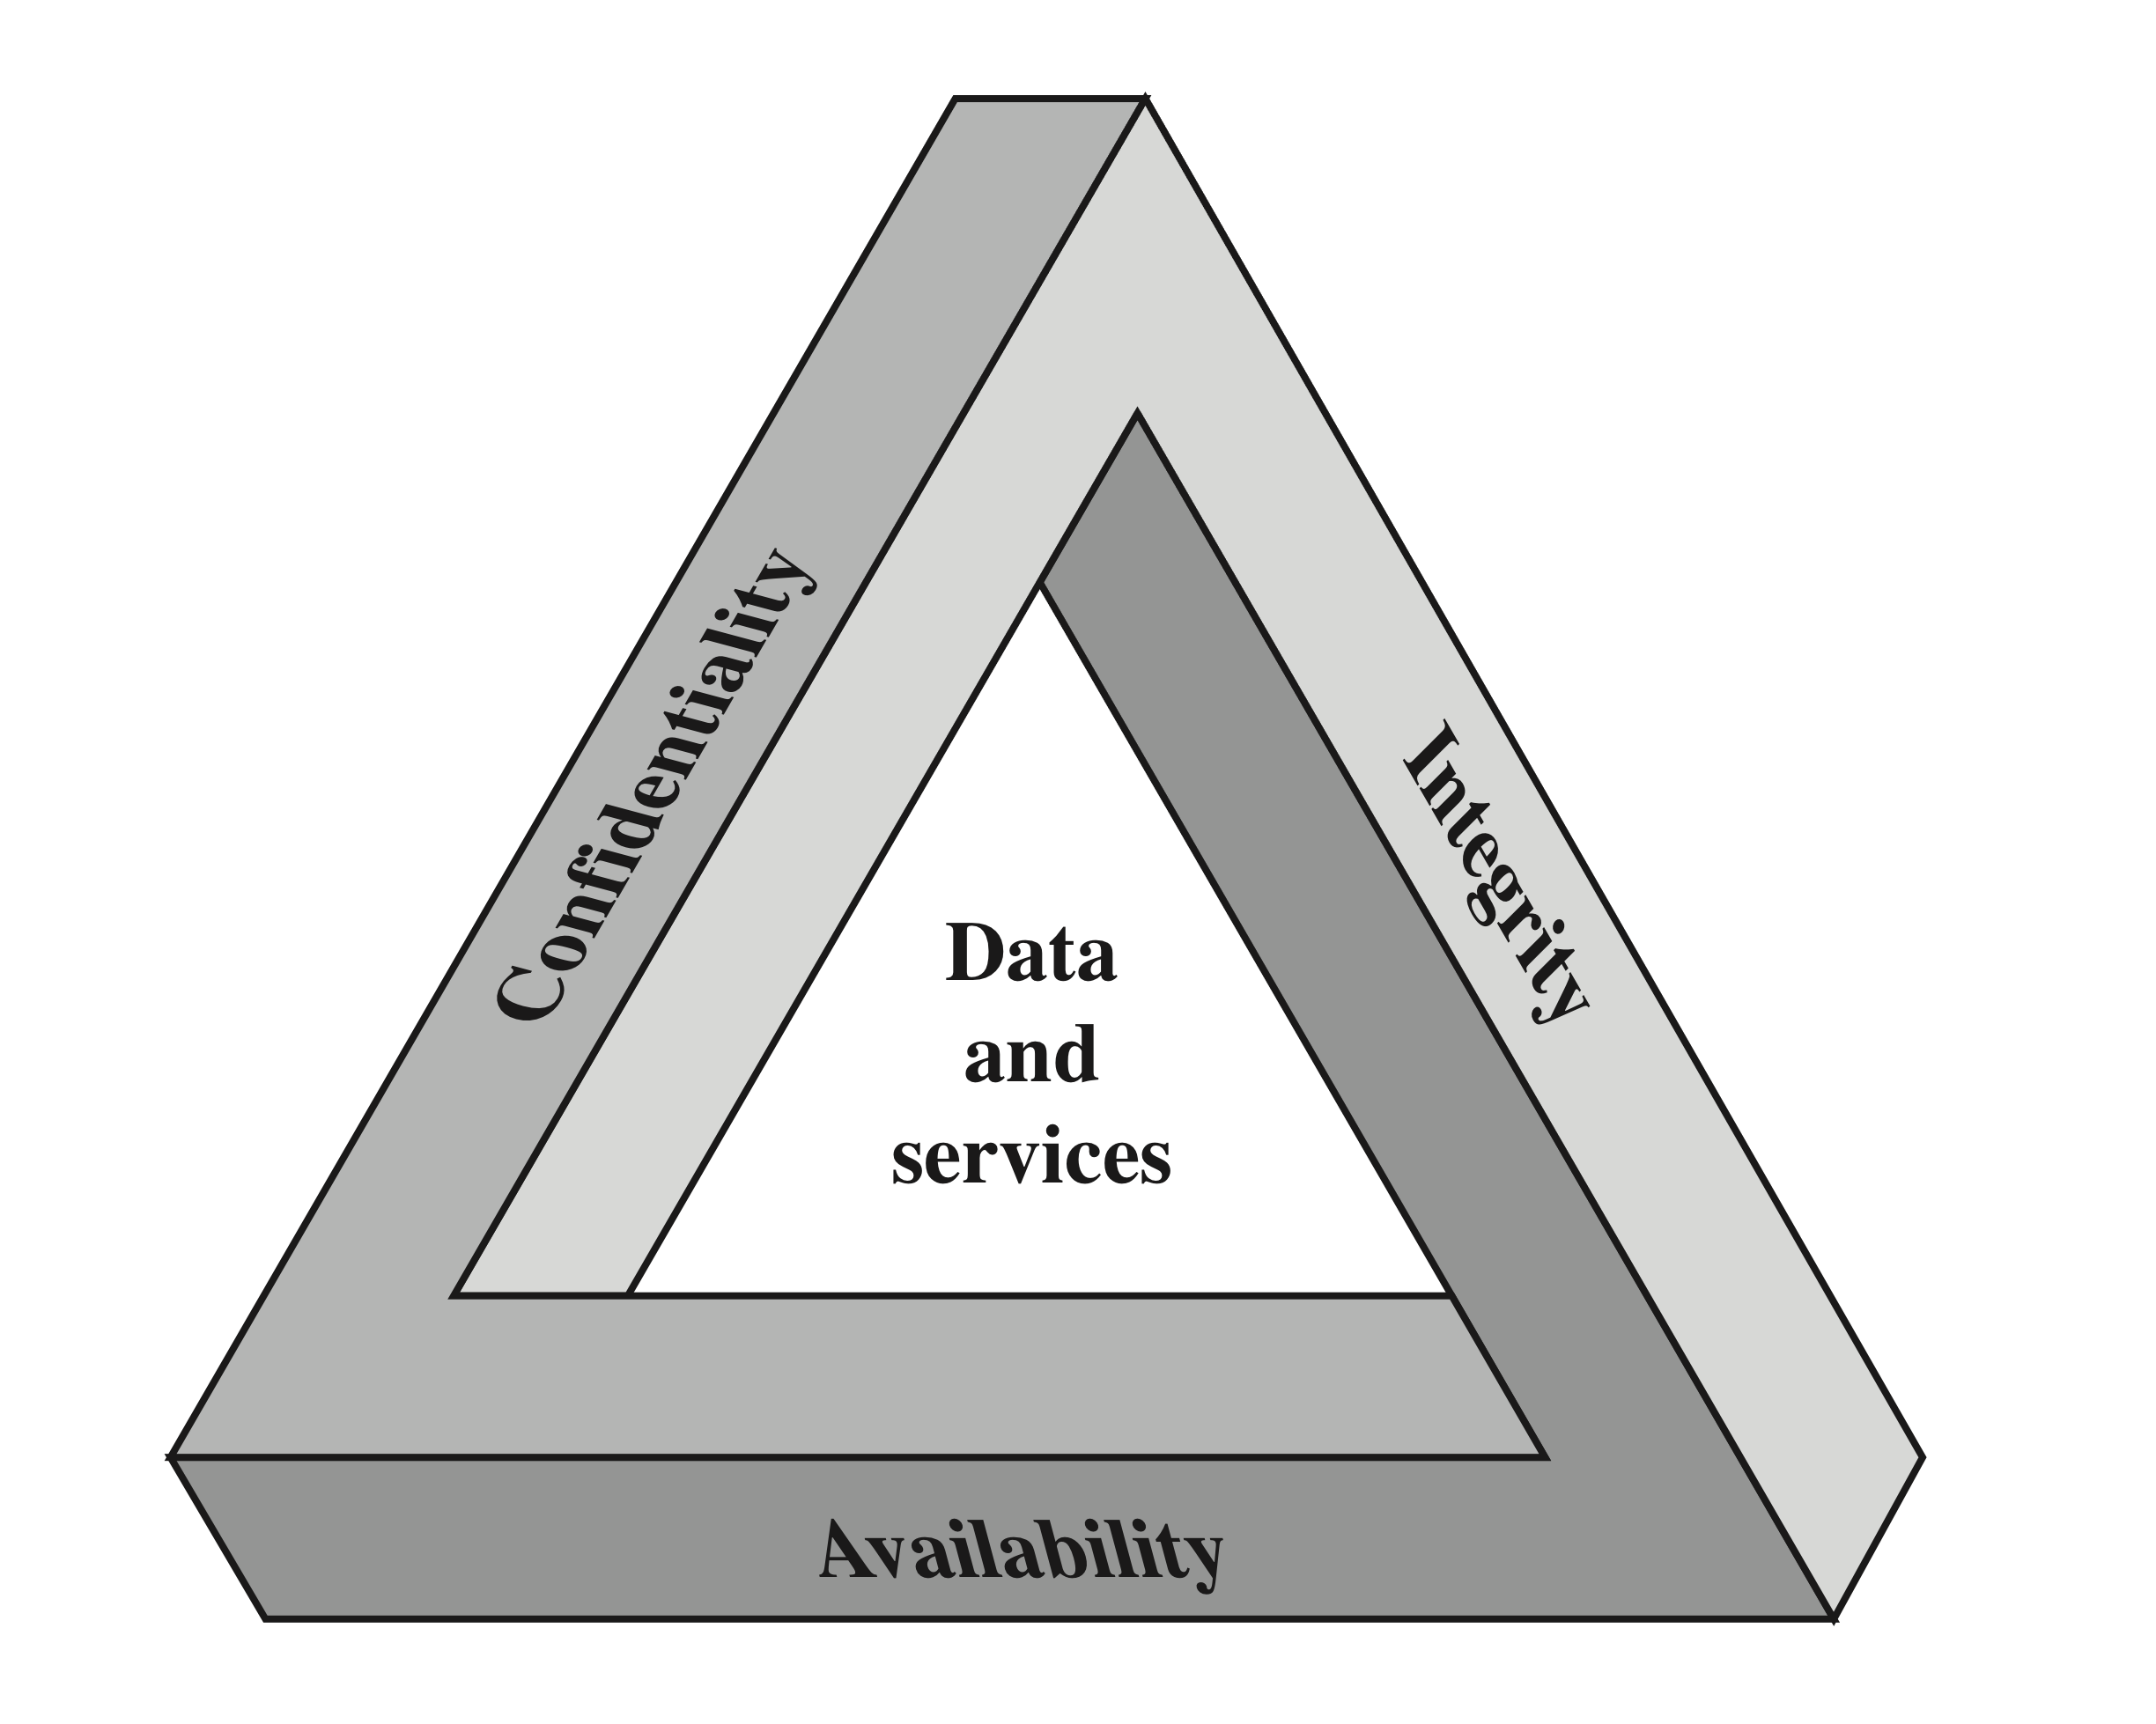
CIA Triad
Notes:
These three concepts form what is often referred to as the CIA triad . The
three concepts embody the fundamental security objectives for both data and for
information and computing services. For example, the NIST Standards for Security
Categorization of Federal Information and Information Systems (FIPS 199) lists
confidentiality, integrity, and availability as the three security objectives for information
and for information systems. FIPS 199 provides a useful characterization
of these three objectives in terms of requirements and the definition of a loss of
security in each category.
• Confidentiality: Preserving authorized restrictions on information access
and disclosure, including means for protecting personal privacy and proprietary
information. A loss of confidentiality is the unauthorized disclosure of
information.
• Integrity: Guarding against improper information modification or destruction,
including ensuring information nonrepudiation and authenticity. A loss of
integrity is the unauthorized modification or destruction of information.
• Availability: Ensuring timely and reliable access to and use of information.
A loss of availability is the disruption of access to or use of information or an
information system.

Slide 13
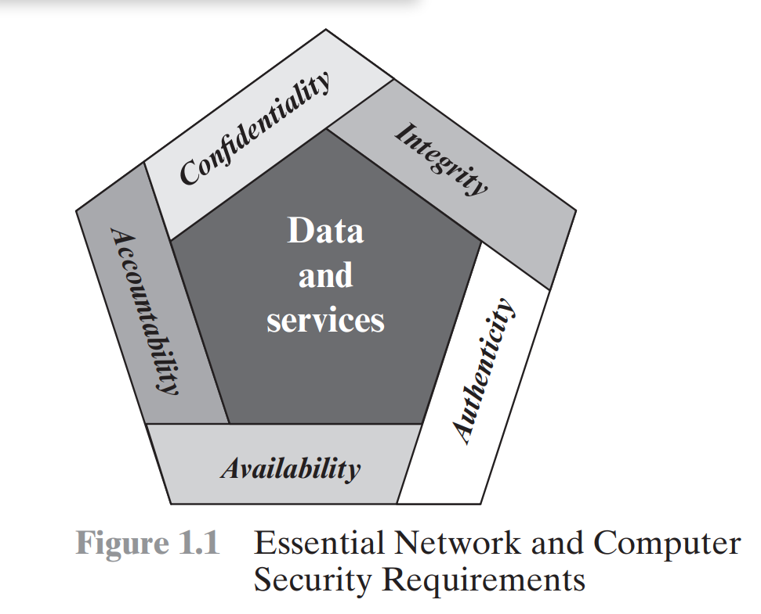
Essential Network and Computer Security Requirements
Notes:
اعتبار-مسئوليت-محرمانه بودن-دسترسی-یکپارچگی

Slide 14
Possible additional concepts:
Authenticity
Verifying that users are who they say they are and that each input arriving at the system came from a trusted source
Accountability
The security goal that generates the requirement for actions of an entity to be traced uniquely to that entity
Notes:
Although the use of the CIA triad to define security objectives is well established,
some in the security field feel that additional concepts are needed to present
a complete picture. Two of the most commonly mentioned are as follows:
• Authenticity: The property of being genuine and being able to be verified and
trusted; confidence in the validity of a transmission, a message, or message
originator. This means verifying that users are who they say they are and that
each input arriving at the system came from a trusted source.
• Accountability: The security goal that generates the requirement for actions
of an entity to be traced uniquely to that entity. This supports nonrepudiation,
deterrence, fault isolation, intrusion detection and prevention, and after action
recovery and legal action. Because truly secure systems are not yet an
achievable goal, we must be able to trace a security breach to a responsible
party. Systems must keep records of their activities to permit later forensic
analysis to trace security breaches or to aid in transaction disputes.

Slide 15
Breach of Security Levels of Impact
High
The loss could be expected to have a severe or catastrophic adverse effect on organizational operations, organizational assets, or individuals
Moderate
The loss could be expected to have a serious adverse effect on organizational operations, organizational assets, or individuals
Low
The loss could be expected to have a limited adverse effect on organizational operations, organizational assets, or individuals
Notes:
تاثیر نقض سطوح امنیتی
We use three levels of impact on organizations or individuals should there be a breach of security (i.e., a loss of confidentiality, integrity,
or availability). These levels are defined in FIPS PUB 199: • Low: for example, the loss of confidentiality, integrity, or availability
might (i) cause a degradation in mission capability to an extent and duration that the organization is able to perform its primary functions, but the
effectiveness of the functions is noticeably reduced; (ii) result in minor damage
to organizational assets; (iii) result in minor financial loss; or (iv) result in
minor harm to individuals.
• Moderate میانه: The loss could be expected to have a serious adverse effect on organizational operations, organizational assets, or individuals. A serious
adverse effect means that, for example, the loss might (i) cause a significant degradation in mission capability to an extent and duration that the
organization is able to perform its primary functions, but the effectiveness of the functions is significantly reduced; (ii) result in significant damage to
organizational assets; (iii) result in significant financial loss; or (iv) result in significant harm to individuals that does not involve loss of life or serious,
life-threatening injuries.
• High: result in major damage to organizational assets; (iii) result in major financial loss; or (iv) result in severe or catastrophic harm to individuals
involving loss of life or serious, life-threatening injuries.

Slide 16
Examples of Security Requirements
Confidentiality
Student grade information is an asset whose confidentiality is considered to be highly important by students
Regulated by the Family Educational Rights and Privacy Act (FERPA)
Integrity
Patient information stored in a database – inaccurate information could result in serious harm or death to a patient and expose the hospital to massive liability
A Web site that offers a forum to registered users to discuss some specific topic would be assigned a moderate level of integrity
An example of a low-integrity requirement is an anonymous online poll
Availability
The more critical a component or service, the higher the level of availability required
A moderate availability requirement is a public Web site for a university
An online telephone directory lookup application would be classified as a low-availability requirement
Notes:
محرمانه بودن
اطلاعات نمره دانش آموز دارایی است که محرمانه بودن آن از نظر دانش آموزان بسیار مهم است. در ایالات متحده، انتشار چنین اطلاعاتی توسط قانون حقوق آموزشی خانواده و حریم خصوصی (FERPA) تنظیم می شود. اطلاعات نمرات فقط باید در دسترس دانش آموزان، والدین و کارمندانی باشد که برای انجام کارشان به این اطلاعات نیاز دارند. اطلاعات ثبت نام دانشجو ممکن است دارای رتبه محرمانه متوسطی باشد. در حالی که هنوز تحت پوشش
FERPA، این اطلاعات توسط افراد بیشتری به صورت روزانه دیده می شود، احتمال کمتری دارد
هدفمند از اطلاعات درجه است، و در صورت افشای آسیب کمتری به دنبال خواهد داشت. فهرست راهنما
ممکن است اطلاعاتی (مانند لیست های دانشجویان، اساتید، یا دپارتمان ها) اختصاص داده شود
رتبه بندی محرمانه پایین یا در واقع بدون رتبه. این اطلاعات معمولاً آزادانه است
در دسترس عموم است و در وب سایت یک مدرسه منتشر می شود.
تمامیت
چندین جنبه از صداقت با مثال یک بیمارستان نشان داده شده است
اطلاعات آلرژی بیمار در یک پایگاه داده ذخیره شده است. دکتر باید بتواند
اطمینان داشته باشید که اطلاعات صحیح و جاری است. حال فرض کنید که یک کارمند
(به عنوان مثال، یک پرستار) که مجاز به مشاهده و به روز رسانی عمدی این اطلاعات است
داده ها را جعل می کند تا به بیمارستان آسیب برساند. پایگاه داده باید بازیابی شود
به سرعت به یک پایه قابل اعتماد، و باید امکان ردیابی خطا به آن وجود داشته باشد
فرد مسئول. اطلاعات آلرژی بیمار نمونه ای از دارایی با بالا است
لازمه صداقت اطلاعات نادرست می تواند منجر به آسیب جدی شود یا
مرگ بر یک بیمار و قرار گرفتن بیمارستان در معرض مسئولیت بزرگ.
نمونه ای از دارایی که ممکن است سطح متوسطی از یکپارچگی به آن اختصاص داده شود
الزامات وب سایتی است که برای کاربران ثبت نام شده انجمنی برای بحث در مورد برخی از آنها ارائه می دهد
موضوع خاص یک کاربر ثبت نام شده یا یک هکر می تواند برخی از ورودی ها را جعل کند یا خراب کند
تارنما. اگر انجمن فقط برای لذت بردن کاربران وجود داشته باشد، می آورد
درآمد تبلیغاتی کم یا بدون درآمد است و برای موارد مهمی از این قبیل استفاده نمی شود
به عنوان تحقیق، پس آسیب احتمالی شدید نیست. ممکن است استاد وب تجربه کند
برخی از داده ها، مالی و از دست دادن زمان.
نمونه ای از الزامات با یکپارچگی پایین، یک نظرسنجی آنلاین ناشناس است. زیاد
وب سایت ها، مانند سازمان های خبری، این نظرسنجی ها را با تعداد بسیار کمی در اختیار کاربران خود قرار می دهند
پادمان ها با این حال، نادرستی و غیر علمی بودن چنین نظرسنجی هایی خوب است
درک کرد.
دسترسی
هر چه یک جزء یا سرویس حیاتی تر باشد، سطح آن بالاتر است
در دسترس بودن مورد نیاز است. سیستمی را در نظر بگیرید که خدمات احراز هویت را برای آن ارائه می کند
سیستم ها، برنامه ها و دستگاه های حیاتی قطع خدمات منجر به
ناتوانی مشتریان در دسترسی به منابع محاسباتی و دسترسی کارکنان
منابعی که برای انجام وظایف حیاتی نیاز دارند. از دست دادن خدمات ترجمه می شود
به دلیل از دست دادن بهره وری و پتانسیل کارکنان، به ضرر مالی زیادی وارد می شود
از دست دادن مشتری
نمونه ای از دارایی که معمولاً به عنوان دارایی متوسط رتبه بندی می شود
شرط در دسترس بودن یک وب سایت عمومی برای یک دانشگاه است. وب سایت ارائه می دهد
اطلاعات برای دانشجویان و اهداکنندگان فعلی و آینده. چنین سایتی یک نیست
جزء حیاتی سیستم اطلاعاتی دانشگاه است، اما در دسترس نبودن آن خواهد بود
باعث شرمندگی شود
یک برنامه جستجوی فهرست تلفن آنلاین به عنوان در دسترس کم طبقه بندی می شود
نیاز اگرچه ممکن است از دست دادن موقت برنامه باشد
یک مزاحم، راه های دیگری برای دسترسی به اطلاعات وجود دارد، مانند نسخه چاپی
دایرکتوری یا اپراتور

Slide 17

Computer Security Challenges
1-Security is not simple
-Potential attacks on the security features need to be considered
3-Procedures used to provide particular services are often counter-intuitive (We can’t now what mechanism are need based on a specific requirement)
4-It is necessary to decide where to use the various security mechanisms
5- Security mechanisms typically involve more than a particular algorithm or protocol
6-Security is essentially a battle of wits(reasoning power) between a perpetrator and the designer
7-Little benefit from security investment is perceived until a security failure occurs
8-Requires constant monitoring
9-Is too often an afterthought
10-Strong security is often viewed as an impediment(obstruction) to efficient and user-friendly operation
Notes:
impediment: مانع
Witsعقلانی:
امنیت کامپیوتر و شبکه هم جذاب و هم پیچیده است. برخی از دلایل عبارتند از:
1. امنیت به آن سادگی که ممکن است در ابتدا برای تازه کار به نظر برسد نیست. به نظر می رسد الزامات ساده هستند. در واقع، بسیاری از الزامات اصلی برای
به سرویس‌های امنیتی می‌توان برچسب‌های تک کلمه‌ای و قابل توضیح داد: محرمانگی، احراز هویت، عدم انکار، و یکپارچگی. اما مکانیسم های استفاده شده است
برآوردن این الزامات می تواند بسیار پیچیده باشد و درک آنها ممکن است مستلزم استدلال نسبتاً ظریف باشد.
2. در توسعه یک مکانیسم یا الگوریتم امنیتی خاص، همیشه باید
حملات احتمالی به آن ویژگی های امنیتی را در نظر بگیرید. در بسیاری از موارد موفق است
حملات با نگاهی کاملا متفاوت به مشکل طراحی می شوند،
بنابراین از یک ضعف غیرمنتظره در مکانیسم استفاده می شود.
3. به دلیل بند 2، رویه های مورد استفاده برای ارائه خدمات خاص هستند
اغلب غیر شهودی به طور معمول، یک مکانیسم امنیتی پیچیده است، و اینطور نیست
از بیان یک الزام خاص که چنین توضیح دقیقی پیدا می کند
اقدامات لازم است. تنها زمانی است که جنبه های مختلف تهدید در نظر گرفته شود
که مکانیسم های امنیتی دقیق منطقی است.
4. با طراحی مکانیسم های امنیتی مختلف، باید تصمیم گرفت که کجا
برای استفاده از آنها این هم از نظر قرارگیری فیزیکی (مثلاً در چه نقاطی) صادق است
در یک شبکه مکانیسم های امنیتی خاصی مورد نیاز است) و به معنای منطقی
[به عنوان مثال، در کدام لایه یا لایه‌های معماری مانند TCP/IP (Transmission
پروتکل کنترل/پروتکل اینترنت) باید مکانیسم هایی قرار داده شود].
5. مکانیسم های امنیتی معمولاً بیش از یک الگوریتم خاص یا
پروتکل آنها همچنین از شرکت کنندگان می خواهند که برخی از اطلاعات سری را در اختیار داشته باشند
(به عنوان مثال، یک کلید رمزگذاری)، که سوالاتی را در مورد ایجاد ایجاد می کند،
توزیع و حفاظت از آن اطلاعات محرمانه همچنین ممکن است یک تکیه وجود داشته باشد
روی پروتکل های ارتباطی که رفتار آنها ممکن است کار را پیچیده کند
توسعه مکانیزم امنیتی به عنوان مثال، اگر عملکرد مناسب
مکانیسم امنیتی مستلزم تعیین محدودیت های زمانی در زمان عبور a
پیام از فرستنده به گیرنده، سپس هر پروتکل یا شبکه ای که معرفی می کند
تأخیرهای متغیر و غیرقابل پیش بینی ممکن است چنین محدودیت های زمانی را بی معنی کند.
6. امنیت رایانه و شبکه اساساً نبرد عقلانی بین یک مجرم است
که سعی می کند سوراخ ها را پیدا کند و طراح یا مدیری که سعی می کند
آنها را ببند مزیت بزرگی که مهاجم دارد این است که او نیاز دارد
تنها یک نقطه ضعف را بیابد، در حالی که طراح باید همه را بیابد و از بین ببرد
نقاط ضعف برای دستیابی به امنیت کامل
7. یک تمایل طبیعی از سوی کاربران و مدیران سیستم وجود دارد
تا زمانی که یک شکست امنیتی رخ ندهد، سود کمی از سرمایه گذاری امنیتی دریافت کنید.
8. امنیت مستلزم نظارت منظم و حتی ثابت است و این امر دشوار است
محیط کوتاه مدت و پربار امروزی.
9-امنیت هنوز خیلی وقت‌ها یک فکر بعدی است که نمی‌توان بعد از آن در یک سیستم گنجانده شد
طراحی به جای اینکه بخشی جدایی ناپذیر از فرآیند طراحی باشد کامل است.
10. بسیاری از کاربران (و حتی مدیران امنیتی) امنیت قوی را به عنوان یک امنیت در نظر می گیرند
مانع از عملکرد کارآمد و کاربر پسند یک اطلاعات
سیستم یا استفاده از اطلاعات
مشکلاتی که به تازگی برشمردیم، مانند ما به طرق متعددی با آن مواجه خواهیم شد
تهدیدها و مکانیسم‌های امنیتی مختلف را در این کتاب بررسی کنید.
Computer and network security is both fascinating and complex. Some of the reasonsinclude:
1. Security is not as simple as it might first appear to the novice. The requirements seem to be straightforward; indeed, most of the major requirements for
security services can be given self-explanatory, one-word labels: confidentiality, authentication, nonrepudiation, and integrity. But the mechanisms used to
meet those requirements can be quite complex, and understanding them may involve rather subtle reasoning.
2. In developing a particular security mechanism or algorithm, one must always
consider potential attacks on those security features. In many cases, successful
attacks are designed by looking at the problem in a completely different way,
therefore exploiting an unexpected weakness in the mechanism.
3. Because of point 2, the procedures used to provide particular services are
often counterintuitive. Typically, a security mechanism is complex, and it is not
obvious from the statement of a particular requirement that such elaborate
measures are needed. It is only when the various aspects of the threat are considered
that elaborate security mechanisms make sense.
4. Having designed various security mechanisms, it is necessary to decide where
to use them. This is true both in terms of physical placement (e.g., at what points
in a network are certain security mechanisms needed) and in a logical sense
[e.g., at what layer or layers of an architecture such as TCP/IP (Transmission
Control Protocol/Internet Protocol) should mechanisms be placed].
5. Security mechanisms typically involve more than a particular algorithm or
protocol. They also require that participants be in possession of some secret information
(e.g., an encryption key), which raises questions about the creation,
distribution, and protection of that secret information. There also may be a reliance
on communications protocols whose behavior may complicate the task
of developing the security mechanism. For example, if the proper functioning
of the security mechanism requires setting time limits on the transit time of a
message from sender to receiver, then any protocol or network that introduces
variable, unpredictable delays may render such time limits meaningless.
6. Computer and network security is essentially a battle of wits between a perpetrator
who tries to find holes and the designer or administrator who tries to
close them. The great advantage that the attacker has is that he or she need
only find a single weakness, while the designer must find and eliminate all
weaknesses to achieve perfect security.
۹. There is a natural tendency on the part of users and system managers to
perceive little benefit from security investment until a security failure occurs.
8. Security requires regular, even constant, monitoring, and this is difficult in
today’s short-term, overloaded environment.
9. Security is still too often an afterthought to be incorporated into a system after
the design is complete rather than being an integral part of the design process.
10. Many users (and even security administrators) view strong security as an
impediment to efficient and user-friendly operation of an information
system or use of information.
The difficulties just enumerated will be encountered in numerous ways as we
examine the various security threats and mechanisms throughout this book.

Slide 18
OSI Security Architecture
open systems interconnection (OSI)
Security attack
Any action that compromises the security of information owned by an organization
Security mechanism
A process (or a device incorporating such a process) that is designed to detect, prevent, or recover from a security attack
Security service
A processing or communication service that enhances the security of the data processing systems and the information transfers of an organization
Intended to counter security attacks, and they make use of one or more security mechanisms to provide the service
Notes:
برای ارزیابی موثر نیازهای امنیتی یک سازمان و ارزیابی و انتخاب محصولات امنیتی و سیاست های مختلف، مدیر مسئول کامپیوتر و امنیت شبکه به روشی سیستماتیک برای تعریف الزامات نیاز دارد
برای امنیت و مشخص کردن رویکردهای برآورده کردن این الزامات. این به اندازه کافی در یک محیط پردازش داده متمرکز دشوار است. با استفاده از شبکه های محلی و گسترده، مشکلات مرکب شده است.
ITU-T Recommendation X.800، معماری امنیتی برای OSI، چنین چیزی را تعریف می کند.
رویکرد سیستماتیک. معماری امنیتی OSI به عنوان یک راه برای مدیران مفید است
سازماندهی وظیفه تامین امنیت. علاوه بر این، زیرا این معماری
به عنوان یک استاندارد بین المللی، کامپیوتر و فروشندگان ارتباطات توسعه داده شد
ویژگی های امنیتی را برای محصولات و خدمات خود توسعه داده اند که به این موضوع مربوط می شود
تعریف ساختار یافته خدمات و مکانیسم ها
برای اهداف ما، معماری امنیتی OSI اگر انتزاعی باشد مفید است، مروری بر بسیاری از مفاهیمی که این کتاب به آنها می پردازد. معماری امنیتی OSI
بر حملات امنیتی، مکانیسم ها و خدمات تمرکز دارد. اینها را می توان تعریف کرد به طور خلاصه به عنوان
• حمله امنیتی: هر اقدامی که امنیت اطلاعات را به خطر می اندازد متعلق به یک سازمان
• مکانیسم امنیتی: فرآیندی (یا دستگاهی که چنین فرآیندی را در خود جای داده است) که
برای شناسایی، پیشگیری یا بازیابی از یک حمله امنیتی طراحی شده است.
• خدمات امنیتی: یک سرویس پردازش یا ارتباطی که باعث افزایش
امنیت سیستم های پردازش داده و انتقال اطلاعات یک
سازمان. این سرویس ها برای مقابله با حملات امنیتی در نظر گرفته شده اند
از یک یا چند مکانیسم امنیتی برای ارائه خدمات استفاده کنید.
To assess effectively the security needs of an organization and to evaluate and
choose various security products and policies, the manager responsible for computer
and network security needs some systematic way of defining the requirements
for security and characterizing the approaches to satisfying those requirements.
This is difficult enough in a centralized data processing environment; with the use of
local and wide area networks, the problems are compounded.
ITU-T Recommendation X.800, Security Architecture for OSI , defines such a
systematic approach. The OSI security architecture is useful to managers as a way
of organizing the task of providing security. Furthermore, because this architecture
was developed as an international standard, computer and communications vendors
have developed security features for their products and services that relate to this
structured definition of services and mechanisms.
For our purposes, the OSI security architecture provides a useful, if abstract,
overview of many of the concepts that this book deals with. The OSI security architecture
focuses on security attacks, mechanisms, and services. These can be defined
briefly as
• Security attack: Any action that compromises the security of information
owned by an organization.
• Security mechanism: A process (or a device incorporating such a process) that
is designed to detect, prevent, or recover from a security attack.
• Security service: A processing or communication service that enhances the
security of the data processing systems and the information transfers of an
organization. The services are intended to counter security attacks, and they
make use of one or more security mechanisms to provide the service.

Slide 19
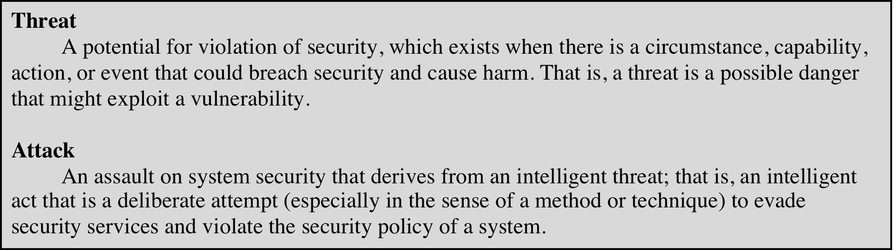
Table 1.1 Threats and Attacks (RFC 4949)
Notes:
In the literature, the terms threat and attack are commonly used to mean more
or less the same thing. Table 1.1 provides definitions taken from RFC 4949, Internet
Security Glossary.

Slide 20
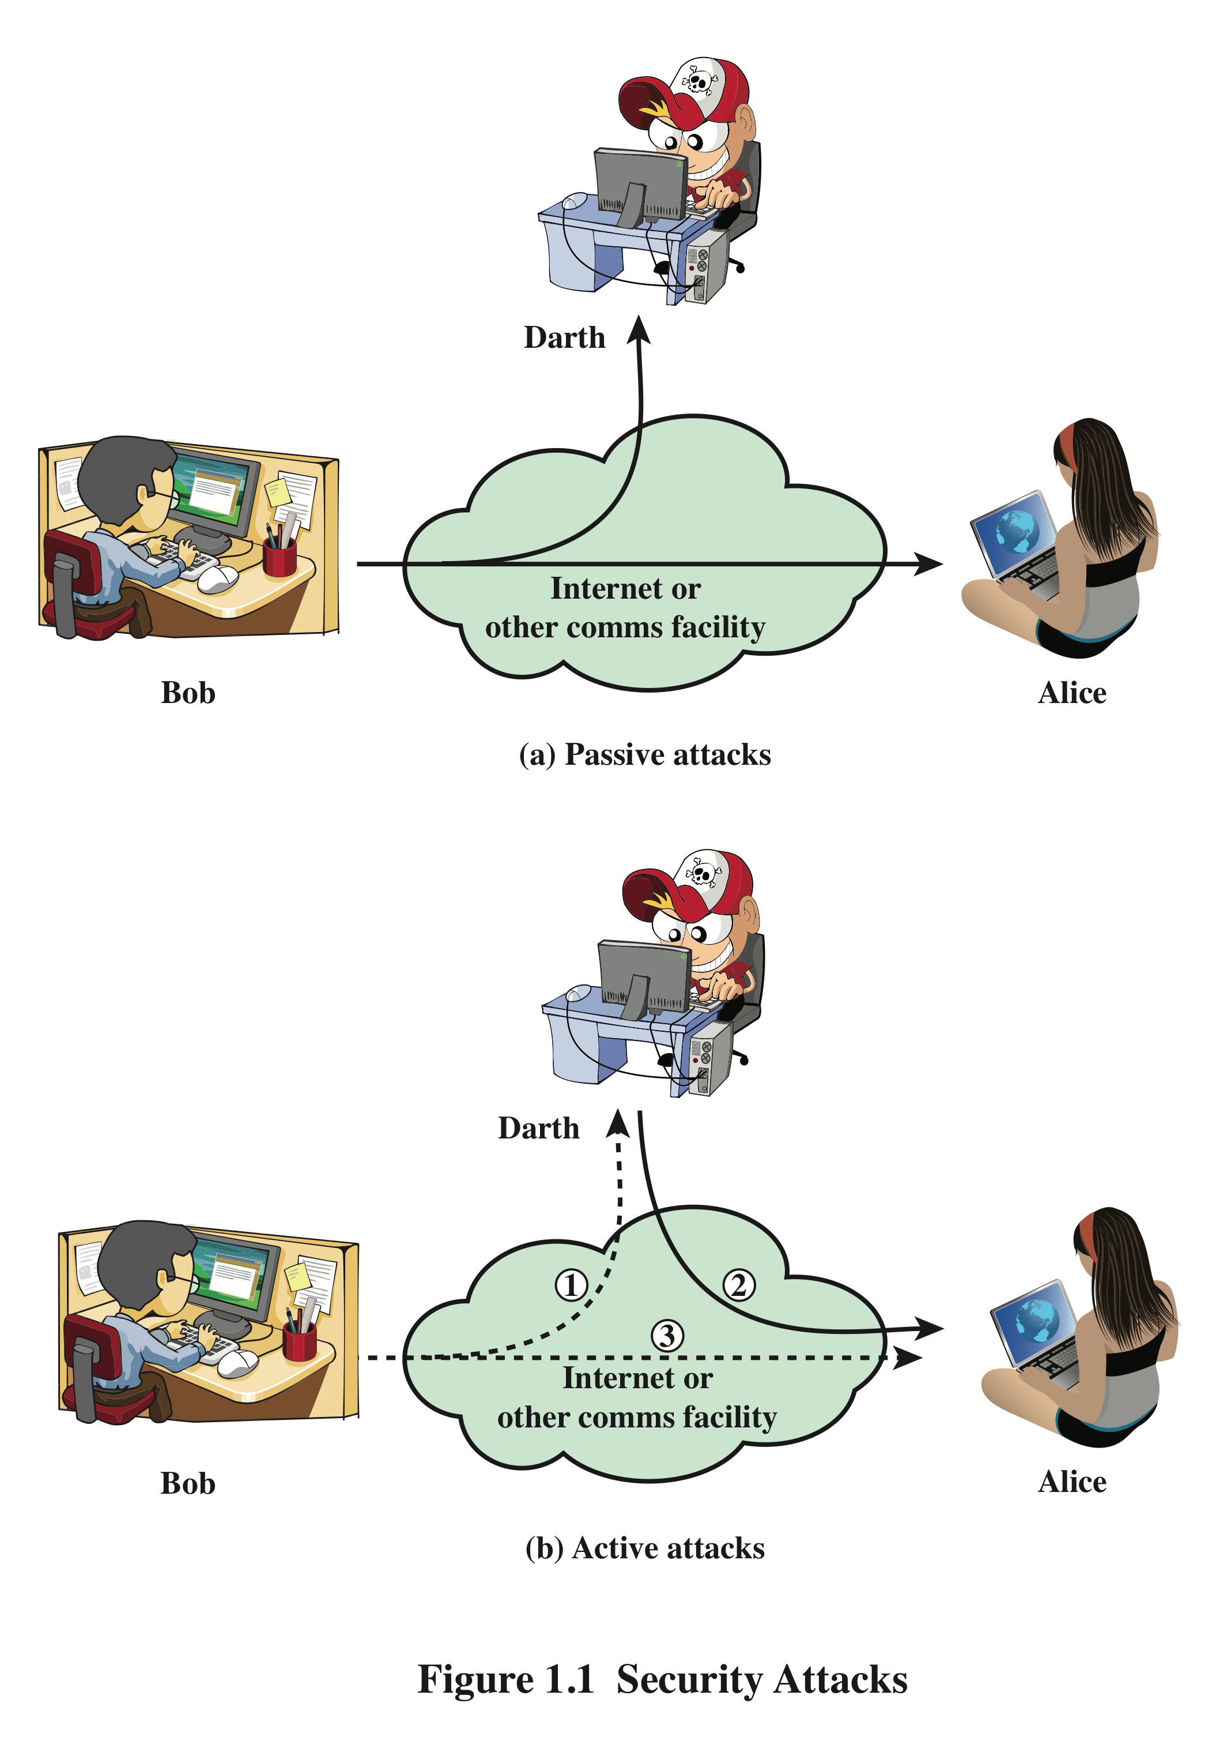
Security Attacks
A means of classifying security attacks, used both in X.800 (Standard) and RFC 4949( informational document), is in terms of passive attacks and active attacks
A passive attack attempts to learn or make use of information from the system but does not affect system resources
An active attack attempts to alter system resources or affect their operation
Notes:
یک ابزار مفید برای طبقه بندی حملات امنیتی، که هم در X.800 و هم در RFC 4949 استفاده می شود، در
شرایط حملات غیرفعال و حملات فعال (شکل 1.1). یک حمله غیرفعال سعی در یادگیری یا استفاده از اطلاعات سیستم دارد، اما بر منابع سیستم تأثیر نمی گذارد.
یک حمله فعال سعی می کند منابع سیستم را تغییر دهد یا بر عملکرد آنها تأثیر بگذارد.
بخش استانداردسازی ارتباطات از راه دور اتحادیه بین‌المللی (ITU) (ITU-T) یک آژانس تحت حمایت سازمان ملل متحد است که استانداردهایی به نام توصیه‌ها را در ارتباط با ارتباطات راه دور و اتصال بین سیستم‌های باز (OSI) توسعه می‌دهد.
X.800 استانداردی است که سرویس‌های امنیتی و پروتکل‌هایی را تعریف می‌کند که برای ایمن کردن ارتباطات در سیستم‌های باز استفاده می‌شوند. این سرویس به عنوان "خدمتی ارائه شده توسط یک لایه پروتکل از سیستم های باز ارتباطی ارائه می شود و امنیت کافی سیستم ها یا انتقال داده ها را تضمین می کند."
1. RFC 4949 یک سند اطلاعاتی است که واژه نامه ای از اصطلاحات مربوط به امنیت سیستم اطلاعاتی را ارائه می دهد. برای امنیت سیستم اطلاعات تعاریف، اختصارات و توضیحات اصطلاحات را ارائه می کند
2. واژه‌نامه مرجع گسترده‌ای است که باید به جامعه اینترنتی کمک کند تا وضوح اسناد و بحث را در زمینه مهمی از فناوری اینترنت بهبود بخشد.
A useful means of classifying security attacks, used both in X.800 and RFC 4949, is in
terms of passive attacks and active attacks (Figure 1.1). A passive attack attempts to
learn or make use of information from the system but does not affect system resources.
An active attack attempts to alter system resources or affect their operation.
The International Telecommunication Union (ITU) Telecommunication Standardization Sector (ITU-T) is a United Nations-sponsored agency that develops standards, called Recommendations, relating to telecommunications and to open systems interconnection (OSI).
X.800 is a standard that defines the security services and protocols that are used to secure communication over open systems. It is defined as “a service provided by a protocol layer of communicating open systems and that ensures adequate security of the systems or of data transfers” ¹.
RFC 4949 is an informational document that provides a glossary of terms related to information system security. It provides definitions, abbreviations, and explanations of terminology for information system security ². The glossary is an extensive reference that should help the Internet community to improve the clarity of documentation and discussion in an important area of Internet technology ².

Slide 21
Passive Attacks
Are in the nature of eavesdropping on, or monitoring of, transmissions
Goal of the opponent is to obtain information that is being transmitted
Two types of passive attacks are:
The release of message contents
Traffic analysis
Hard to detect.
We usually try to prevent rather than detection
Notes:
حملات غیرفعال (شکل 1.1) ماهیت استراق سمع یا نظارت دارند
نوع دوم حمله غیرفعال، تجزیه و تحلیل ترافیک، ظریف تر است. فرض کنید که ما راهی برای پنهان کردن محتوای پیام ها یا سایر ترافیک اطلاعاتی داشتیم تا مخالفان، حتی اگر پیام را دریافت کردند، نتوانند اطلاعات را از پیام استخراج کنند. روش رایج برای پوشاندن محتوا رمزگذاری است. اگر ما
اگر محافظت از رمزگذاری وجود داشته باشد، ممکن است حریف همچنان بتواند الگوی این پیام‌ها را مشاهده کند. حریف می‌توانست مکان و هویت میزبان‌های در حال ارتباط را تعیین کند و فرکانس و طول پیام‌ها را مشاهده کند
شناسایی حملات غیرفعال بسیار دشوار است، زیرا هیچ گونه تغییری در داده ها ندارد. به طور معمول، ترافیک پیام به شکل ظاهراً عادی ارسال و دریافت می شود و نه فرستنده و نه گیرنده آگاه نیستند که شخص ثالثی پیام ها را خوانده یا الگوی ترافیک را مشاهده کرده است. با این حال، جلوگیری از موفقیت این حملات معمولاً با استفاده از رمزگذاری امکان پذیر است.
. 1. مهاجم می تواند از این اطلاعات برای پیش بینی ماهیت ارتباط استفاده کند. 2. تجزیه و تحلیل ترافیک می تواند توسط استخراج ویژگی‌ها از یک جریان خاص در یک طرف شبکه و جستجوی آن ویژگی‌ها در طرف دیگر.
مثال: یک هکر سعی می کند به همان شبکه ای دسترسی پیدا کند که شما برای گوش دادن (و ضبط) تمام ترافیک شبکه شما. از آنجا، هکر می تواند آن ترافیک را تجزیه و تحلیل کند تا چیزی در مورد شما یا شرکت شما بیاموزد. برای مثال، با جستجوی الگوها در ترافیک ضبط شده، مهاجم می‌تواند بفهمد که شما معمولاً چه زمانی از خواب بیدار می‌شوید و می‌خوابید. نام دستگاه و مکان را به آن اضافه کنید، و اکنون مهاجم می داند چه زمانی خانه خود را ترک می کنید و چه زمانی معمولاً برمی گردید.
عنوان مثال، اگر مهاجم تعداد زیادی بسته با اندازه 1 کیلوبایت و فرکانس 10 بسته در ثانیه را مشاهده کند، احتمالاً یک ویدیو در حال پخش جریانی 1 است.

Slide 22
Active Attacks
Involve some modification of the data stream or the creation of a false stream
Difficult to prevent because of the wide variety of potential physical, software, and network vulnerabilities
Goal is to detect attacks and to recover from any disruption or delays caused by them

Slide 23
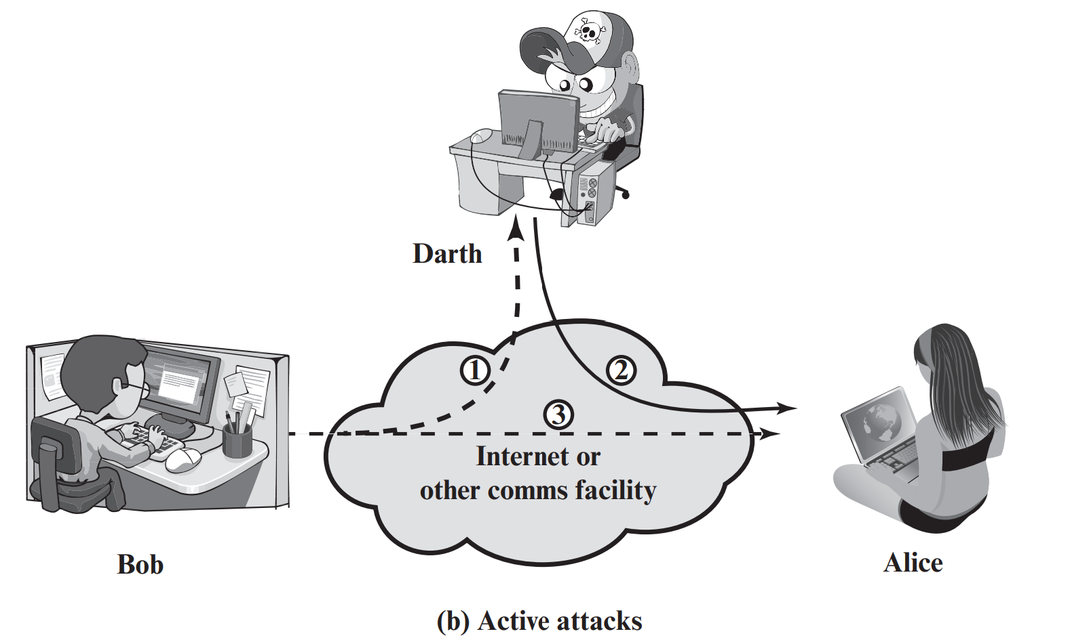
Active Attacks
Masquerade
Takes place when one entity pretends to be a different entity
Usually includes one of the other forms of active attack (path 2 active)
Replay
Involves the passive capture of a data unit and its subsequent retransmission to produce an unauthorized effect( paths 1,2,3 active)
Modification of messages
Some portion of a legitimate message is altered, or messages are delayed or reordered to produce an unauthorized effect (path 1 and 2 active)
Denial of service
Prevents or inhibits the normal use or management of communications facilities (path 3 active)
Notes:
Active attacks present the opposite characteristics of passive attacks. Whereas
passive attacks are difficult to detect, measures are available to prevent their success.
On the other hand, it is quite difficult to prevent active attacks absolutely
because of the wide variety of potential physical, software, and network vulnerabilities.
Instead, the goal is to detect active attacks and to recover from any disruption
or delays caused by them. If the detection has a deterrent effect, it may also
contribute to prevention.

Slide 24
Active Attacks examples
Masquerade
authentication sequences can be captured and replayed after a valid authentication sequence has taken place, thus enabling an authorized entity with few privileges to obtain extra privileges by impersonating anentity that has those privileges. E.x, Macro virus attack, Stolen or compromised logins, IP address spoofing
Replay
For example, consider a scenario where a user logs into their bank account by providing their username and password. The attacker intercepts this communication and records the user’s credentials. Later, the attacker replays the same communication to the bank’s server, pretending to be the user, and gains access to the user’s account without their knowledge
Modification of messages
For example, a message meaning “Allow John Smith to read confidential file accounts ” is modified to mean “Allow Fred Brown to read confidential file accounts. ”
Denial of service
an entity may suppress all messages directed to a particular destination
(e.g., the security audit service). Another form of service denial is the disruption of an entire network, either by disabling the network or by overloading it withmessages so as to degrade performance.
Authorizing bank transfers, Compromising SSL sessions
Notes:
masquerade: 1:Pass the hash attack: In this attack, the attacker penetrates one device and uses the password hashes stored on that device to laterally move up the permissions chain, stealing more hashes and repeating the process as needed.
Macro virus attack: In this attack, a macro virus is crafted to steal credentials.
Stolen or compromised logins: An attacker can use stolen or compromised logins to masquerade as a legitimate user and gain access to a device.
IP address spoofing(IPجعل آدرس): An attacker can use IP address spoofing to masquerade as a legitimate and authenticated device.
-Replay involves the passive capture of a data unit and its subsequent retransmissionto produce an unauthorized effect (paths 1, 2, and 3 active).
Authorizing bank transfers: A hacker copies a packet sent between you and your bank. Sending that again could prompt the bank to repeat the action (such as transferring funds again, but this time to a different destination) ²
Compromising SSL sessions: An attacker can capture an SSL session and replay it to gain unauthorized access to a system.
-Modification of messages simply means that some portion of a legitimate
message is altered, or that messages are delayed or reordered, to produce an
unauthorized effect (paths 1 and 2 active). For example, a message meaning “Allow
John Smith to read confidential file accounts ” is modified to mean “Allow Fred
Brown to read confidential file accounts. ”
The denial of service prevents or inhibits the normal use or management of
communications facilities (path 3 active). This attack may have a specific target; for
example, an entity may suppress all messages directed to a particular destination
(e.g., the security audit service). Another form of service denial is the disruption
of an entire network, either by disabling the network or by overloading it with
messages so as to degrade performance.
Ping of Death: In this attack, the attacker sends an oversized ping packet to a server or network device, causing it to crash or reboot.
SYN Flood: In this attack, the attacker sends a large number of SYN requests to a server, but never completes the three-way handshake process. This causes the server to allocate resources for each incomplete connection request, eventually leading to a denial of service ¹.
Teardrop Attack: In this attack, the attacker sends fragmented packets with overlapping offsets to a server or network device. When the device tries to reassemble the packets, it crashes or reboots ¹.
Smurf Attack: In this attack, the attacker sends an ICMP echo request (ping) packet to a broadcast address on a network. All devices on that network respond with an echo reply packet, overwhelming the target device with traffic ¹.

Slide 25
Security Services
Defined by X.800 as:
A service provided by a protocol layer of communicating open systems and that ensures adequate security of the systems or of data transfers
Defined by RFC 4949 as:
A processing or communication service provided by a system to give a specific kind of protection to system resources
Notes:
X.800 یک سرویس امنیتی را به عنوان سرویسی تعریف می کند که توسط یک لایه پروتکل از سیستم های باز ارتباطی ارائه می شود و امنیت کافی سیستم ها یا انتقال داده ها را تضمین می کند. شاید تعریف واضح‌تری در RFC 4949 یافت شود که تعریف زیر را ارائه می‌کند: یک سرویس پردازش یا ارتباط که توسط یک سیستم برای ایجاد نوع خاصی از حفاظت از منابع سیستم ارائه می‌شود.
سرویس های امنیتی سیاست های امنیتی را اجرا می کنند و توسط مکانیسم های امنیتی اجرا می شوند.
X.800 defines a security service as a service that is provided by a protocol layer of
communicating open systems and that ensures adequate security of the systems
or of data transfers. Perhaps a clearer definition is found in RFC 4949, which
provides the following definition: a processing or communication service that is
provided by a system to give a specific kind of protection to system resources;
security services implement security policies and are implemented by security
mechanisms.

Slide 26
X.800 Service Categories
X.800 divides these services into five categories.
Authentication
Access control
Data confidentiality
Data integrity
Nonrepudiation
Notes:
احراز هویت
کنترل دسترسی
محرمانه بودن داده ها
یکپارچگی داده
عدم انکار

Slide 27
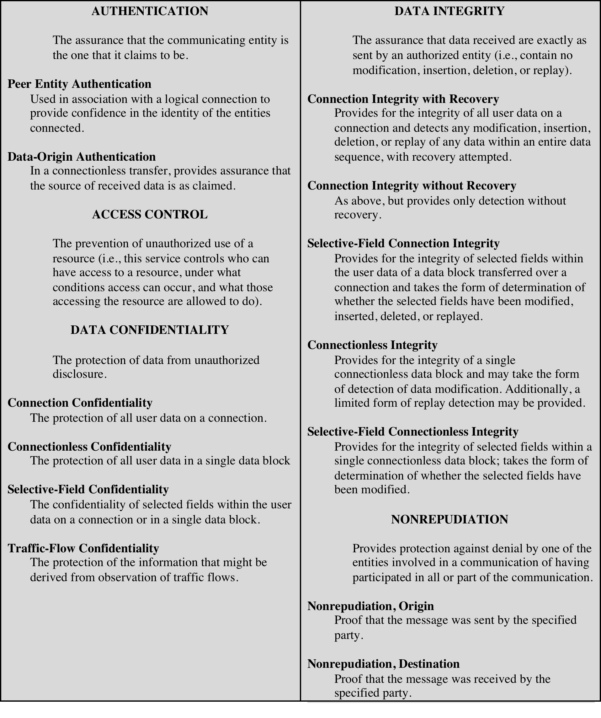
Table 1.2
Security Services
(X.800)
(This table is found on page 12 in the textbook)
Notes:
X.800 divides these services into five categories and fourteen specific services
(Table 1.2).

Slide 28
Authentication
Concerned with assuring that a communication is authentic
In the case of a single message, assures the recipient that the message is from the source that it claims to be from
In the case of ongoing interaction, assures the two entities are authentic and that the connection is not interfered with in such a way that a third party can masquerade as one of the two legitimate parties
Two specific authentication services are defined in X.800:
Peer Entity Authentication(اعتبارسنجي واحد نظير:): Used in association with a logical connection to provide confidence in the identity of the entities connected. (Two entities are considered peers if they implement to same protocol in different systems; for example two TCP modules
Data-Origin Authentication (اعتبارسنجي منبع ديتا:): In a connectionless transfer, provides assurance that the source of received data is as claimed. (e.g., Email)
Notes:
The authentication service is concerned with assuring that a communication is
authentic. In the case of a single message, such as a warning or alarm signal, the
function of the authentication service is to assure the recipient that the message
is from the source that it claims to be from. In the case of an ongoing interaction,
such as the connection of a terminal to a host, two aspects are involved. First,
at the time of connection initiation, the service assures that the two entities are
authentic, that is, that each is the entity that it claims to be. Second, the service
must assure that the connection is not interfered with in such a way that a third
party can masquerade as one of the two legitimate parties for the purposes of
unauthorized transmission or reception.
Two specific authentication services are defined in X.800:
• Peer entity authentication: Provides for the corroboration of the identity
of a peer entity in an association. Two entities are considered peers if they
implement to same protocol in different systems; for example two TCP modules
in two communicating systems. Peer entity authentication is provided for
use at the establishment of, or at times during the data transfer phase of, a
connection. It attempts to provide confidence that an entity is not performing
either a masquerade or an unauthorized replay of a previous connection.
• Data origin authentication: Provides for the corroboration of the source of a
data unit. It does not provide protection against the duplication or modification
of data units. This type of service supports applications like electronic mail,
where there are no prior interactions between the communicating entities.

Slide 29
Access Control
The ability to limit and control the access to host systems and applications via communications links
To achieve this, each entity trying to gain access must first be indentified, or authenticated, so that access rights can be tailored to the individual
Notes:
در زمینه امنیت شبکه، کنترل دسترسی توانایی محدود کردن و کنترل دسترسی به سیستم ها و برنامه های میزبان از طریق پیوندهای ارتباطی است. برای دستیابی به این هدف، هر نهادی که تلاش می‌کند دسترسی پیدا کند، ابتدا باید شناسایی یا احراز هویت شود، تا بتوان حقوق دسترسی را برای فرد تنظیم کرد.
In the context of network security, access control is the ability to limit and control
the access to host systems and applications via communications links. To achieve
this, each entity trying to gain access must first be identified, or authenticated, so
that access rights can be tailored to the individual.

Slide 30

Data Confidentiality
The protection of transmitted data from passive attacks
Broadest service protects all user data transmitted between two users over a period of time
Narrower forms of service include the protection of a single message or even specific fields within a message
The protection of traffic flow from analysis
This requires that an attacker not be able to observe the source and destination, frequency, length, or other characteristics of the traffic on a communications facility
Notes:
-گسترده ترین سرویس از تمام داده های کاربر که بین دو کاربر در یک دوره زمانی منتقل می شود محافظت می کند. به عنوان مثال، هنگامی که یک اتصال TCP بین دو سیستم تنظیم می شود، این حفاظت گسترده از انتشار هر گونه داده کاربر که از طریق اتصال TCP منتقل می شود جلوگیری می کند.
- اشکال باریک تری از این سرویس را نیز می توان تعریف کرد، از جمله محافظت از یک پیام واحد یا حتی فیلدهای خاص در یک پیام.
این اصلاحات کمتر از رویکرد گسترده مفید هستند و حتی ممکن است پیاده سازی پیچیده تر و پرهزینه تر باشند.

Slide 31
Data Confidentiality
Data Confidentiality: The protection of data from unauthorized disclosure.
Connection Confidentiality: The protection of all user data on a connection.
Connectionless Confidentiality: The protection of all user data in a single data block.
Selective-Field Confidentiality: The confidentiality of selected fields within the user data on a connection or in a single data block. only certain parts of the data are kept confidential, while others may be visible
Traffic-Flow Confidentiality: The protection of the information that might be derived from observation of traffic flows
Notes:
۱-محرمانگي اتصالي
حفاظت از تمام دادة كاربر در طول اتصال
For example, when you access a website using HTTPS, your connection to the website is encrypted using SSL/TLS protocols. This means that any data transmitted between your computer and the website is encrypted and cannot be intercepted by third parties.
Another example of connection confidentiality is when you use a virtual private network (VPN) to connect to a remote network. The VPN encrypts all data transmitted between your computer and the remote network, ensuring that it cannot be intercepted by unauthorized parties.
۲-محرمانگي غيراتصالي
حفاظت از تمام دادة كاربر در يك بلوك منفرد
For example, when you send an email using PGP (Pretty Good Privacy), the email message is encrypted using a public key. The recipient can then decrypt the message using their private key. This ensures that the message is protected from unauthorized access or interception.
Another example of connectionless confidentiality is when you use a secure file transfer protocol (SFTP) to transfer files between two systems. The files are encrypted during transmission, ensuring that they cannot be intercepted by unauthorized parties
۳-محرمانگي ميدان انتخابي
محرمانگي ميدانهاي انتخاب شده دادة كاربر در تمام يك اتصال و يا در يك بلوك ديتا
۴-محرمانگي جريان ترافيك
حفاظت از اطلاعاتي كه ممكن است از مشاهدة جريان ترافيك دادهها بدست آيد.
one example of Traffic-Flow Confidentiality is the use of traffic padding. If your data policy is configured for tunnel mode, you can use traffic padding to conceal the actual length of the data packets transferred over a VPN connection. TFC adds extra padding to the packets being sent and sends dummy packets with different lengths at random intervals to conceal the actual length of the packets ⁴.
Another example of Traffic-Flow Confidentiality is the use of dummy traffic in addition to the encryption of actual messages and sender and receiver addresses. This can make it look like a system is experiencing a consistently high level of traffic in order to obscure the actual volume of traffic in the network ¹.

Slide 32
Data Integrity
Can apply to a stream of messages, a single message, or selected fields within a message
Connection-oriented integrity service deals with a stream of messages and assures that messages are received as sent with no duplication, insertion, modification, reordering, or replays
A connectionless integrity service deals with individual messages without regard to any larger context and generally provides protection against message modification only
Notes:
همانند محرمانه بودن، یکپارچگی می تواند برای جریانی از پیام ها، یک پیام واحد یا فیلدهای انتخاب شده در یک پیام اعمال شود. باز هم، مفیدترین و ساده ترین رویکرد، حفاظت از جریان کامل است.
یک سرویس یکپارچگی اتصال گرا، سرویسی که با جریانی از پیام ها سروکار دارد، تضمین می کند که پیام ها به صورت ارسالی بدون تکرار، درج، تغییر، ترتیب مجدد یا پخش مجدد دریافت می شوند. تخریب داده ها نیز تحت پوشش این سرویس است. بنابراین، سرویس یکپارچگی اتصال گرا هر دو پیام را نشان می دهد
اصلاح جریان و انکار سرویس.
TCP ensures that all data transmitted between the two systems is received as sent and in the correct order. If any data is lost or corrupted during transmission, TCP will request that the data be retransmitted ².
Another example of connection-oriented integrity is when you use a virtual private network (VPN) to connect to a remote network. The VPN verifies the integrity of all user data on the connection and detects any modification, insertion, deletion, or replay of any data within an entire data sequence ¹.
سرویس یکپارچگی بدون اتصال، سرویسی که با پیام‌های فردی بدون توجه به زمینه بزرگ‌تر سروکار دارد، عموماً فقط در برابر تغییر پیام محافظت می‌کند.
For example, when you use User Datagram Protocol (UDP) to transfer data between two systems, the protocol provides connectionless integrity. UDP ensures that all data transmitted between the two systems is received as sent and in the correct order. However, unlike TCP, UDP does not provide error checking or retransmission of lost packets ³.
ما می توانیم بین خدمات با و بدون بازیابی تمایز قائل شویم.
از آنجایی که سرویس یکپارچگی مربوط به حملات فعال است، ما به جای پیشگیری، نگران شناسایی هستیم. اگر نقض یکپارچگی تشخیص داده شود، سرویس ممکن است به سادگی این تخلف را گزارش کند و بخش دیگری از نرم افزار یا مداخله انسانی برای بازیابی از نقض مورد نیاز است. روش دیگر، وجود دارد
مکانیسم های موجود برای بازیابی از دست دادن یکپارچگی داده ها، همانطور که بعداً بررسی خواهیم کرد. ترکیب مکانیزم های بازیابی خودکار، به طور کلی، جایگزین جذاب تر است.
As with confidentiality, integrity can apply to a stream of messages, a single message,
or selected fields within a message. Again, the most useful and straightforward
approach is total stream protection.
A connection-oriented integrity service, one that deals with a stream of messages,
assures that messages are received as sent with no duplication, insertion,
modification, reordering, or replays. The destruction of data is also covered under
this service. Thus, the connection-oriented integrity service addresses both message
stream modification and denial of service. On the other hand, a connectionless integrity
service, one that deals with individual messages without regard to any larger
context, generally provides protection against message modification only.
We can make a distinction between service with and without recovery.
Because the integrity service relates to active attacks, we are concerned with detection
rather than prevention. If a violation of integrity is detected, then the service
may simply report this violation, and some other portion of software or human
intervention is required to recover from the violation. Alternatively, there are
mechanisms available to recover from the loss of integrity of data, as we will review
subsequently. The incorporation of automated recovery mechanisms is, in general,
the more attractive alternative.

Slide 33
Data Integrity
Data Integrity: The assurance that data received are exactly as sent by an authorized entity (i.e., contain no modification, insertion, deletion, or replay).
Connection Integrity with Recovery: Provides for the integrity of all user data on a connection and detects any modification, insertion, deletion, or replay of any data within an entire data sequence, with recovery attempted.
Connection Integrity without Recovery: As above, but provides only detection without recovery.
Selective-Field Connection Integrity: Provides for the integrity of selected fields within the user data of a data block transferred over a connection and takes the form of determination of whether the selected fields have been modified, inserted, deleted, or replayed.
Connectionless Integrity: Provides for the integrity of a single connectionless data block and may take the form of detection of data modification. Additionally, a limited form of replay detection may be provided.
Selective-Field Connectionless: Integrity Provides for the integrity of selected fields within a single connectionless data block; takes the form of determination of whether the selected fields have been modified.
Notes:
۱-.صحت اتصالي با بازيابي (Recovery with Integrity Connection (
صحت كل دادة كاربر روي يك اتصال را تأئيد كرده و هرگونه تغيير،
حذف، اضافه، و يا بازخواني دادهها در يك دنبالة كامل ديتا را تشخيص
ميدهد. بازيابي داده نيز مورد نظر است.
۲-صحت اتصالي بدون بازيابي(Recovery without Integrity Connection (
همانند مورد بالاست، ولي تنها تشخيص و نه بازيابي مورد توجه است.
۳-صحت اتصالي ميدانهاي انتخابي
(Selective-Field Connection Integrity)
صحت ميدانهاي انتخابشده ةاي از داد كاربر در يك بلوك را بعهده
داشته و تعيين ميكند كه آيا ميدانهاي انتخابشده تغييريافته، حذف يا
اضافه شده و يا بازخو نا ي شدهاند.
۴-صحت غيراتصالي (Integrity Connectionless (
صحت يك بلوك ديتاي منفرد را تعيين نموده و ممكن است قدرت
تشخيص تغيير داده را داشته باشد. علاوه برآن توان محدودي از تشخيص
بازخواني را نيز ميتواند تأمين كند.
۵-صحت غيراتصالي ميدانهاي انتخابي
(Selective-Field Connectionless Integrity)
صحت ميدانهاي انتخاب شدهاي در يك بلوك ديتاي غيراتصالي را تعيين
ميكند. مشخص ميكند كه آيا ميدانهاي مورد نظر تغيير يافتهاند

Slide 34

Nonrepudiation
Prevents either sender or receiver from denying a transmitted message
Digital signatures can be used to validate the authenticity of a message while tying it to a specific user or organization. They can also provide timestamps to authenticate the message further.
e.x., when you send an email using PGP (Pretty Good Privacy), you can digitally sign your email message using your private key. The recipient can then verify your digital signature using your public key.
Notes:
عدم انکار فرستنده یا گیرنده از انکار پیام ارسال شده جلوگیری می کند.
بنابراین، هنگامی که یک پیام ارسال می شود، گیرنده می تواند ثابت کند که فرستنده ادعایی در واقع پیام را ارسال کرده است. به طور مشابه، هنگامی که یک پیام دریافت می شود، فرستنده می تواند ثابت کند که گیرنده ادعا شده در واقع پیام را دریافت کرده است.
For example, when you sign a legal contract with a pen, your signature is a non-repudiation device. You cannot later disagree to the terms of the contract or refute ever taking part in the agreement ⁴.
In digital security, non-repudiation is achieved through digital signatures, which provide proof of the origin and integrity of data ⁵. Digital signatures can be used to validate the authenticity of a message while tying it to a specific user or organization. They can also provide timestamps to authenticate the message further ⁶.
For example, when you send an email using PGP (Pretty Good Privacy), you can digitally sign your email message using your private key. The recipient can then verify your digital signature using your public key. This ensures that the message is protected from unauthorized access or interception and that it originated from you ¹.

Slide 35
Nonrepudiation
Nonrepudiation: Provides protection against denial by one of the entities involved in a communication of having participated in all or part of the communication.
Nonrepudiation, Origin: Proof that the message was sent by the specified party.
Nonrepudiation, Destination: Proof that the message was received by the specified party
Notes:
X.800 divides these services into five categories.

Slide 36
Availability service
Availability
The property of a system or a system resource being accessible and usable upon demand by an authorized system entity, according to performance specifications for the system
Availability service
One that protects a system to ensure its availability
Addresses the security concerns raised by denial-of-service attacks
Depends on proper management and control of system resources
Notes:
A variety of attacks can result in the loss of or reduction
in availability. Some of these attacks are amenable to automated countermeasures,
such as authentication and encryption, whereas others require some sort
of physical action to prevent or recover from loss of availability of elements of a
distributed system.
X.800 treats availability as a property to be associated with various security
services. However, it makes sense to call out specifically an availability service. An
availability service is one that protects a system to ensure its availability. This service
addresses the security concerns raised by denial-of-service attacks. It depends
on proper management and control of system resources and thus depends on access
control service and other security services.

Slide 37
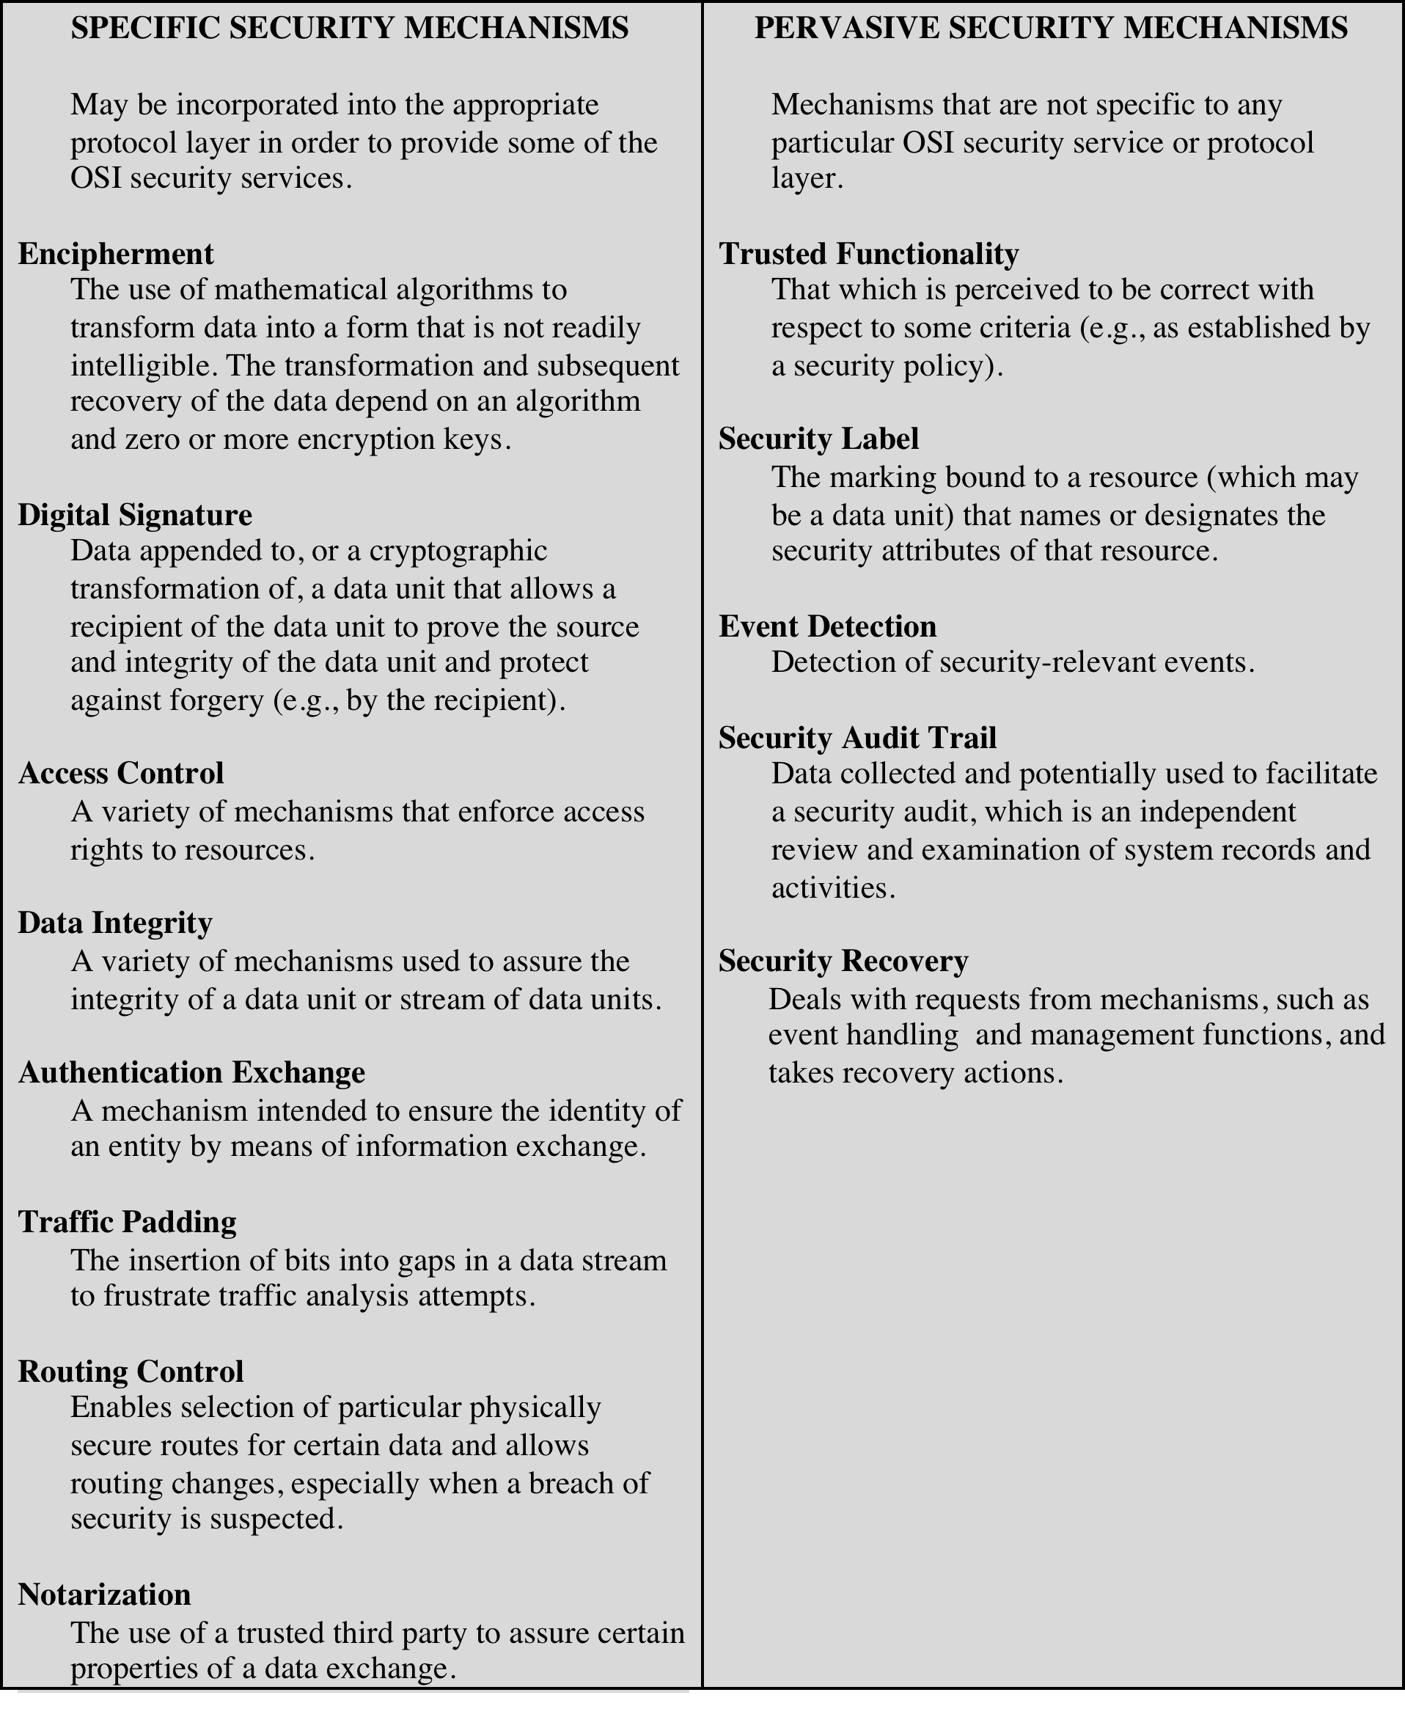
Table 1.3
Security Mechanisms
(X.800)
(This table is found on page 15 in the textbook)
Notes:
Table 1.3 lists the security mechanisms defined in X.800. The mechanisms are
divided into those that are implemented in a specific protocol layer, such as TCP
or an application-layer protocol, and those that are not specific to any particular
protocol layer or security service. These mechanisms will be covered in the
appropriate places in the book, so we do not elaborate now except to comment
on the definition of encipherment. X.800 distinguishes between reversible
encipherment mechanisms and irreversible encipherment mechanisms. A reversible
encipherment mechanism is simply an encryption algorithm that allows data to
be encrypted and subsequently decrypted. Irreversible encipherment mechanisms
include hash algorithms and message authentication codes, which are used in digital
signature and message authentication applications.

Slide 38
Specific Security Mechanisms
: May be incorporated into the appropriate protocol layer in order to provide some of the OSI security services.
Encipherment رمزنگاری: The use of mathematical algorithms to transform data into a form that is not readily intelligible. The transformation and subsequent recovery of the data depend on an algorithm and zero or more encryption keys.
Digital Signature امضا دیجیتال Data appended to, or a cryptographic transformation of, a data unit that allows a recipient of the data unit to prove the source and integrity of the data unit and protect against forgery (e.g., by the recipient). Creates a virtual fingerprint that is unique to the person or entity.
Apply a hash function to a msg using user private key with fix length- hash cannot be reversed.
Access Control: کنترل دستیابی A variety of mechanisms that enforce access rights to resources.
Data Integrity: صحت داده A variety of mechanisms used to assure the integrity of a data unit or stream of data units.
Notes:
Digital signatures create a virtual “fingerprint” that is unique to a person or other entity and can be used to protect the contents of messages and ensure that they were written by who they claim to have been ².
Digital signatures work by applying a hash function to a message. In most cases, a user’s private key will be used to create a “hash,” which is a fixed-length string of numbers and letters. The way in which hash functions work means that this string is totally unique to the message being hashed. In addition, hash functions are also one-way functions — a computed hash cannot be reversed to find other files that may generate the same hash value ².

Slide 39
Specific Security Mechanisms
Specific Security Mechanisms (Continue):
Authentication Exchange مبادله اعتبارسنجی : A mechanism intended to ensure the identity of an entity by means of information exchange. . This is achieved at the TCP/IP layer where two-way handshaking mechanism is used to ensure data is sent or not
Traffic Padding لابلا کردن ترافیک : The insertion of bits into gaps in a data stream to frustrate traffic analysis attempts.
Routing Control کنترل مسیریابیEnables selection of particular physically secure routes for certain data and allows routing changes, especially when a breach of security is suspected.
Notarization ثبت سند The use of a trusted third party to assure certain properties of a data exchange.
Notes:
-Authentication Exchange:for example, when you use mutual authentication, a client and a server take steps to independently verify each other’s identity, instead of only the client authenticating the server. Device-to-device connections, like those between Internet of Things (IoT) devices, often use mutual authentication as well.
Notarization is the official process that assures the parties of a transaction that a document is authentic and can be trusted ¹. It is a three-part process, performed by a Notary Public, that includes vetting, certifying, and record-keeping ¹. Notarizations are sometimes referred to as “notarial acts” ¹.
The central value of notarization lies in the Notary’s impartial screening of a signer for identity, willingness, and awareness. This screening detects and deters document fraud and helps protect the personal rights and property of private citizens from forgers, identity thieves, and exploiters of the vulnerable ¹.

Slide 40
مکانیزم‌های امنیتی فراگیر Pervasive Security Mechanisms
Pervasive Security Mechanisms : Mechanisms that are not specific to any particular OSI security service or protocol layer.
Trusted Functionality That which is perceived to be correct with respect to some criteria. i.e., data follows security rules (e.g., as established by a security policy).
Trusted functionality is a security mechanism that ensures that the processes or devices that provide or access security services are reliable and trustworthy. It means that they follow some criteria, such as a security policy, and that they are not compromised or corrupted by malicious actors. Trusted functionality can be used to either extend the scope or to establish the effectiveness of other security mechanisms, such as encryption, authentication, access control, etc.
For example, a trusted functionality can verify the integrity of a cryptographic key before using it for encryption or decryption.
Security Label The marking bound to a resource (which may be a data unit) that names or designates the security attributes of that resource.
Event Detection Detection of security-relevant events.
Notes:
مکانیسم‌های امنیتی فراگیر: مکانیسم‌هایی که مختص هیچ سرویس امنیتی OSI یا لایه پروتکل خاصی نیستند.
OSI security service
OSI stands for Open Systems Interconnection, which is a conceptual model that describes how different network components communicate and cooperate. OSI divides the network functions into seven layers, each with a specific role and responsibility.
عملكرد مطمئن (Functionality Trusted( اينكه ديتا موافق با شرايط خاصي صحيح باشد (مثلاً بر اساس يك خطمشي امنيتي)
-برچسب امنیتی علامت گذاری محدود به یک منبع (که ممکن است یک واحد داده باشد) که ویژگی های امنیتی آن منبع را نامگذاری یا تعیین می کند.
For example, one provider could use security labels to integrate with SELinux, a Linux-based mandatory access control system. Another provider could use security labels to implement row-level security, a feature that allows different users to see different rows of the same table based on some criteria.
تشخیص رویداد تشخیص رویدادهای مرتبط با امنیت.
Event detection is a security mechanism that monitors the events or actions that occur in a system or network and identifies any anomalies or threats that may compromise the security of the data or resources. Event detection can be used to detect security-relevant events such as unauthorized access, data modification, data leakage, denial of service, malware infection, etc. Event detection can also help to prevent or mitigate the impact of security incidents by alerting the appropriate parties or triggering countermeasures
داده‌های دنباله ممیزی امنیتی جمع‌آوری شده و به طور بالقوه برای تسهیل ممیزی امنیتی، که بررسی و بررسی مستقل سوابق و فعالیت‌های سیستم است، استفاده می‌شود.
بازیابی امنیت با درخواست‌های مکانیسم‌هایی مانند مدیریت رویداد و عملکردهای مدیریت سروکار دارد و اقدامات بازیابی را انجام می‌دهد.

Slide 41
مکانیزم‌های امنیتی فراگیر Pervasive Security Mechanisms
Pervasive Security Mechanisms Security Audit Trail Data collected and potentially used to facilitate a security audit, which is an independent review and examination of system records and activities.
Internal security audit: This is a security audit that is performed by the organization’s own staff or a third-party contractor hired by the organization. The main goal of an internal security audit is to verify that the organization’s security policies, procedures, and controls are effective and aligned with the organization’s objectives and standards.
External security audit: This is a security audit that is performed by an independent auditor or a regulatory agency. The main goal of an external security audit is to validate that the organization’s security practices comply with the relevant laws, regulations, or industry standards. For example, an external security audit may be required for organizations that handle sensitive data, such as health care or financial information.
Penetration test: This is a type of security audit that simulates a real-world attack on the organization’s systems or networks.
Notes:
ردپاي مميزي امنيتي (Trail Audit Security( ديتاي جمعآوريشده كه بطرز مؤثري براي تسهيل يك مميزي امنيتي بكار رود. مروري مستقل بر سوابق سيستم و فعاليتهاي آن است.

Slide 42
مکانیزم‌های امنیتی فراگیر Pervasive Security Mechanisms
Security Recovery Deals with requests from mechanisms, such as event handling and management functions, and takes recovery actions.
Security recovery is a process of restoring the security of an organization’s information systems and data after a cyberattack or a data breach.
Security recovery aims to protect the data assets from further damage, loss, or exposure, and to resume normal business operations as soon as possible. Security recovery can involve various activitie
Notes:
One example of security recovery is the use of backups. Backups are copies of data that can be used to restore systems and data in the event of a security breach or other disaster ². Backups can be used to restore data that has been lost or corrupted, and they can also be used to restore systems that have been damaged or destroyed by a cyber attack ².
Another example of security recovery is the use of incident response plans. Incident response plans are detailed plans that outline the steps that an organization should take in the event of a security breach or cyber attack ³. These plans typically include procedures for identifying and containing the incident, investigating the cause of the incident, and restoring systems and data to their pre-incident state

Slide 43
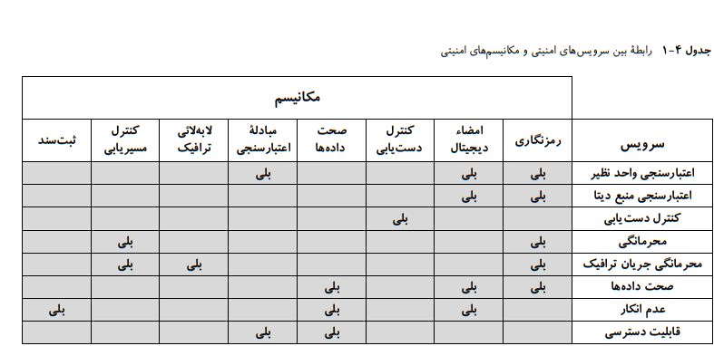
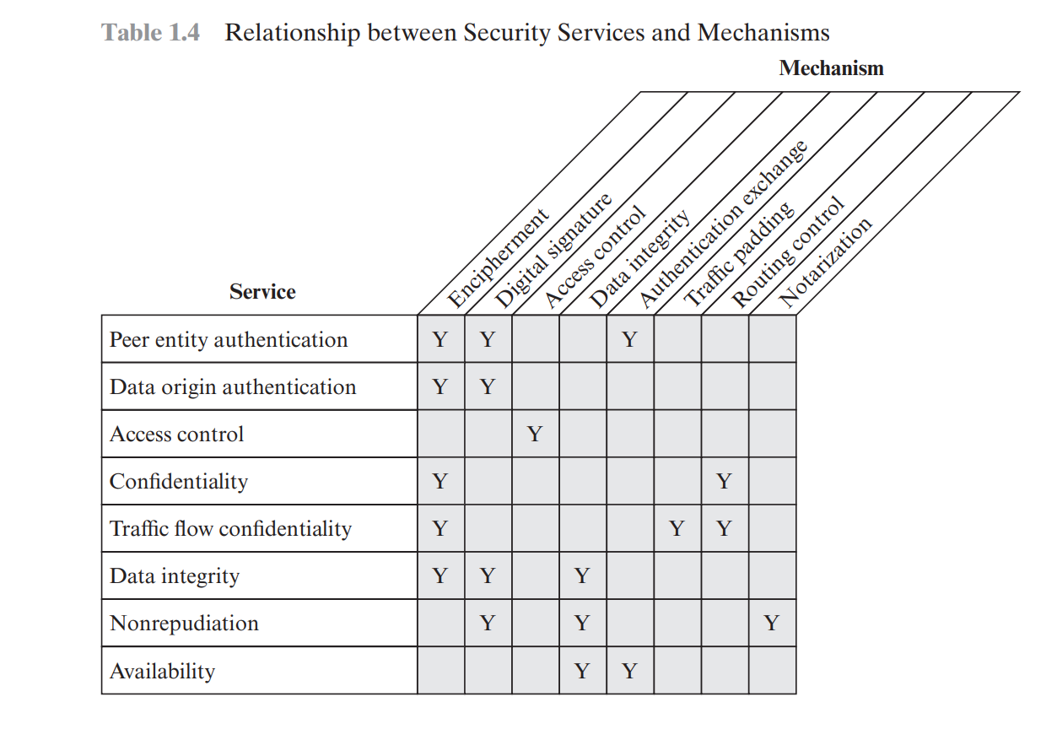
Security mechanisms

Slide 44
Security design principles
The National Centers of Academic Excellence in Information Assurance/Cyber Defense, which is jointly sponsored by the U.S. National Security Agency and the U.S. Department of Homeland Security, list the following as fundamental security design principles [NCAE13]:
■ Economy of mechanism
■ Fail-safe defaults
■ Complete mediation Open design
■ Separation of privilege
■ Least privilege
■ Least common mechanism
■ Psychological acceptability
■ Isolation
■ Encapsulation
■ Modularity
■ Layering
■ Least astonishment
■ سازکار اقتصادی
■ پیش‌فرض‌های بی‌خطر
■ میانجی کامل طراحی باز
■ تفکیک امتیاز
■ کمترین امتیاز
■ کمترین مکانیسم رایج
■ مقبولیت روانی
■ انزوا
■ کپسوله‌سازی
■ مدولار بودن
■ لایه بندی
■ کمترین حیرت
Notes:
مراکز ملی تعالی دانشگاهی در بهبود اطلاعات/دفاع سایبری، که به طور مشترک توسط آژانس امنیت ملی ایالات متحده و وزارت امنیت داخلی ایالات متحده حمایت می شود، موارد زیر را به عنوان اصول اساسی طراحی امنیت فهرست می کند.
■ اقتصاد سازکار
■ پیش‌فرض‌های بی‌خطر
■ میانجی کامل طراحی باز
■ تفکیک امتیاز
■ کمترین امتیاز
■ کمترین مکانیسم رایج
■ مقبولیت روانی
■ انزوا
■ کپسوله‌سازی
■ مدولار بودن
■ لایه بندی
■ کمترین حیرت

Slide 45
Security design principles
Economy of mechanism means that the design of security measures embodied in both hardware and software should be as simple and small as possible. The more complex the mechanism, the more likely it is to possess exploitable flaws. Simple mechanisms tend to have fewer exploitable flaws and require less maintenance
Fail-safe default means that access decisions should be based on permission rather than exclusion. That is, the default situation is lack of access, and the protection scheme identifies conditions under which access is permitted. This approach exhibits a better failure mode than the alternative approach, where the default is to permit access
Complete mediation means that every access must be checked against the access control mechanism. Systems should not rely on access decisions retrieved from a cache.
Open design means that the design of a security mechanism should be open rather than secret. For example, although encryption keys must be secret, encryption algorithms should be open to public scrutiny. The algorithms can then be reviewed by many experts
Separation of privilege is defined as a practice in which multiple privilege attributes are required to achieve access to a restricted resource. A good example of this is multifactor user authentication, which requires the use of multiple techniques, such as a password and a smart card, to authorize a user.
Notes:
Economy of mechanism : One example is the use of a one-time password (OTP) system for authentication. A one-time password is a password that is valid for only one login session or transaction, and is typically generated by an algorithm that uses a secret key and a counter or a timestamp. The OTP system is simple, because it only requires the user to enter a code that is sent to their phone or email, and does not involve complex cryptographic operations or storing passwords in databases. The OTP system is also secure, because it prevents replay attacks, phishing, and brute-force attacks. The principle of economy of mechanism states that security mechanisms should be as simple as possible¹. If a design and implementation are simple, fewer possibilities exist for errors¹. The checking and testing process is less complex, because fewer components and cases need to be tested¹
examples of phishing attacks are:
Advanced-fee scam: The attacker pretends to be someone in need of help or offering a reward, and asks you to pay a small fee upfront. For example, you might receive an email from a “Nigerian prince” who promises to share his fortune with you if you help him transfer his money out of the country².
Account deactivation scam: The attacker pretends to be a service provider that you use, and claims that your account is in danger of being deactivated or suspended. The attacker then asks you to click on a link or enter your login information to verify your identity or fix the problem. For example, you might receive an email from your bank that says your account is on hold due to a billing issue².
Deceptive phishing: The attacker impersonates a legitimate company or organization and tries to get you to reveal your personal or financial information
ترجمه:
-هرچه مکانیسم پیچیده تر باشد، احتمال اینکه دارای نقص های قابل بهره برداری باشد بیشتر است. مکانیسم‌های ساده معمولاً نقص‌های قابل بهره‌برداری کمتری دارند و نیاز به نگهداری کمتری دارند
پیش‌فرض بی‌خطر به این معنی است که تصمیم‌گیری‌های دسترسی باید بر اساس مجوز باشد تا حذف. یعنی وضعیت پیش‌فرض عدم دسترسی است و طرح حفاظت شرایطی را مشخص می‌کند که تحت آن دسترسی مجاز است. این رویکرد حالت شکست بهتری را نسبت به رویکرد جایگزین نشان می‌دهد، که در آن پیش‌فرض اجازه دسترسی است
وساطت کامل به این معنی است که هر دسترسی باید در برابر مکانیسم کنترل دسترسی بررسی شود. سیستم ها نباید به تصمیمات دسترسی بازیابی شده از حافظه پنهان متکی باشند.
طراحی باز به این معنی است که طراحی مکانیزم امنیتی باید باز باشد تا مخفی. به عنوان مثال، اگرچه کلیدهای رمزگذاری باید مخفی باشند، الگوریتم های رمزگذاری باید برای بررسی عمومی باز باشند. سپس الگوریتم ها می توانند توسط بسیاری از کارشناسان بررسی شوند
جداسازی امتیاز در [SALT75] به عنوان یک عمل تعریف شده است که در آن چندین ویژگی امتیاز برای دستیابی به دسترسی به یک منبع محدود مورد نیاز است. یک مثال خوب در این مورد، احراز هویت چندعاملی کاربر است که به استفاده از تکنیک های متعددی مانند رمز عبور و کارت هوشمند برای مجوز دادن به کاربر نیاز دارد.

Slide 46
Security design principles
Least privilege means that every process and every user of the system should operate using the least set of privileges necessary to perform the task. Each role is assigned only those permissions needed to perform its functions.
Least common mechanism means that the design should minimize the functions shared by different users, providing mutual security.
This principle helps reduce the number of unintended communication paths and reduces the amount of hardware and software on which all users depend.
Layering refers to the use of multiple, overlapping protection approaches addressing the people, technology, and operational aspects of information systems. By using multiple, overlapping protection approaches, the failure or circumvention of any individual protection approach will not leave the system unprotect
Notes:
2)Least common mechanism:For example, modern operating systems embody this principle by separating processes into their individual memory spaces. This prevents a bug or security vulnerability in one process from affecting others and avoids unintended information leakage between processes ².
2) layering: example of how layered security can be implemented in a network:
Perimeter security امنیت محیط: This is the first layer of defense and involves securing the network perimeter. It includes firewalls, intrusion detection systems, and intrusion prevention systems.
Network security امنیت شبکه : This layer involves securing the network itself. It includes network segmentation, virtual private networks (VPNs), and access control lists (ACLs).
Host security امنیت میزبان : This layer involves securing individual hosts on the network. It includes antivirus software, host-based firewalls, and host-based intrusion detection systems.
Application security: This layer involves securing applications running on the network. It includes secure coding practices, input validation, and output encoding.
Data security: This layer involves securing data in transit and at rest. It includes encryption, data loss prevention (DLP), and digital rights management (DRM)

Slide 47
Security design principles
Isolation is a principle that applies in three contexts.
1.Public access systems should be isolated from critical resources (data, processes, etc.)
Physical isolation may include ensuring that no physical connection exists between an organization’s public access information resources and an organization’s critical information.
logical isolation 1)layers of security services and mechanisms should be established between public systems and secure systems responsible for protecting critical resources
2.Processes and files of individual users should be isolated from one another except where it is explicitly desired.
Like all modern operating systems provide facilities for such isolation,
3.Security mechanisms should be isolated in the sense of preventing access to those mechanisms.
For example, logical access control may provide a means of isolating cryptographic software from other parts of the host system, and for protecting cryptographic software from tampering and the keys from replacement or disclosure
Notes:
2-All modern operating systems provide facilities for such isolation, so that individual users have separate, isolated process space, memory space,
For example, logical access control may provide a means of isolating cryptographic software from other parts of the host system, and for protecting cryptographic software from tampering and the keys from replacement or disclosure.

Slide 48
Security design principles
Psychological acceptability implies that the security mechanisms should not interfere unduly with the work of users, while at the same time meeting the needs of those who authorize access.
Encapsulation can be viewed as a specific form of isolation based on object oriented functionality. Protection is provided by encapsulating a collection of procedures and data objects in a domain of its own so that the internal structure of a data object is accessible only to the procedures of the protected subsystem, and the procedures may be called only at designated domain entry points.
Notes:
*psychological acceptability is the use of two-factor authentication (2FA). While 2FA can improve security, it can also be seen as an inconvenience by some users. Therefore, it is important to balance the need for security with the need for usability and convenience
if a security system requires users to enter a long and complex password every time they log in, it may be less psychologically acceptable than a system that uses biometric authentication. This is because biometric authentication is more convenient and less intrusive than entering a password
Encapsulation:For example, consider a banking application that stores user account information. Encapsulation would require that the user account information be stored in a separate module that is not accessible to other modules in the application. This would prevent unauthorized access to sensitive user data and reduce the attack surface area of the application ¹.

Slide 49
Security design principles
Modularity in the context of security refers both to the development of security functions as separate, protected modules and to the use of a modular architecture for mechanism design and implementation.
For example, numerous protocols and applications make use of cryptographic functions. Rather than implementing such functions in each protocol or application
Least astonishment means that a program or user interface should always respond in the way that is least likely to astonish the user. i.e., a user interface should behave in a way that is consistent and predictable
For example, the mechanism for authorization should be transparent enough to a user that the user has a good intuitive understanding of how the security goals map to the provided security mechanism
Notes:
Modularity: this principle helps in updating the security mechanism independently without modifying the entire system.
For example 1) consider a network that has multiple components such as routers, switches, and firewalls. Modularity would require that each component be designed as a separate module with its own security mechanism. This would allow for independent updates to each component’s security mechanism without affecting the entire system ².
2) Another example is the use of microservices architecture in software development. Microservices are small, independent modules that can be developed and deployed separately from the rest of the application. This allows for easier maintenance and scalability of the application ³.
-Least astonishment is a design principle that states that a user interface should behave in a way that is consistent and predictable.
EXAMPLES: Password requirements: Password requirements should be designed in a way that is consistent with the user’s expectations. For example, requiring users to enter a long and complex password every time they log in may be less psychologically acceptable than a system that uses biometric authentication. This is because biometric authentication is more convenient and less intrusive than entering a password ². Access control: Access control mechanisms should be designed in a way that is consistent with the user’s expectations. For example, if a user is granted access to a particular resource, they should be able to access it without encountering unexpected barriers or obstacles ³.
Encryption: Encryption mechanisms should be designed in a way that is consistent with the user’s expectations. For example, if a user is required to enter a password to decrypt an encrypted file, the decryption process should be straightforward and easy to understand ⁴.
I hope these examples he

Slide 50
Attack surfaces
Nature of attacks and the types of adversaries that present security threats
Notes:
در نسخه ۴ کتاب ترجمه فارسی نیست این بخش

Slide 51
Attack surfaces سطوح حمله
An attack surface consists of the reachable and exploitable vulnerabilities in a system [MANA11, HOWA03].
Examples of attack surfaces are the following:
■ Open ports on outward facing Web and other servers, and code listening on those ports
■ Services available on the inside of a firewall
■ Code that processes incoming data, e-mail, XML, office documents, and industry-specific custom data exchange formats
■ Interfaces: SQL, and Web forms: injection attacks, cross-site scripting, local file inclusion
■ An employee with access to sensitive information vulnerable to a social engineering attack
Notes:
یک سطح حمله شامل آسیب‌پذیری‌های قابل دسترسی و بهره‌برداری در یک سیستم است [MANA11، HOWA03].
نمونه هایی از سطوح حمله به شرح زیر است:
■ پورت ها را روی وب و سرورهای دیگر که رو به بیرون قرار دارند باز کنید و روی آن پورت ها به کد گوش دهید
وقتی یک پورت باز است، به این معنی است که کامپیوتر به ترافیک ورودی در آن پورت گوش می دهد. اگر سرویسی که در آن پورت اجرا می شود دارای آسیب پذیری باشد، مهاجم می تواند از آن برای دسترسی به سیستم سوء استفاده کند. به عنوان مثال، اگر یک مهاجم یک پورت باز را پیدا کند که نسخه قدیمی یک وب سرور را اجرا می کند، می تواند از آسیب پذیری های شناخته شده در آن نسخه برای دسترسی به سیستم سوء استفاده کند. پس از دسترسی، می توانند از آن برای انجام حملات بیشتر یا سرقت داده های حساس استفاده کنند.
The more commonly used a port is, the easier it can be to sneak attacks in with all the other packets. TCP port 80 for HTTP supports the web traffic that web browsers receive. According to Norby, attacks on web clients that travel over port 80 include SQL injections, cross-site request forgeries, cross-site scripting, and buffer overruns.
For instance, if a port has been opened on a web server, it can be attacked via that port using application-layer attacks ². To reduce the attack surface, it is recommended to limit the number of accessible TCP/IP ports by using a firewall ³
■ خدمات موجود در داخل فایروال
■ کدی که داده‌های دریافتی، ایمیل، XML، اسناد اداری و فرمت‌های تبادل داده سفارشی خاص صنعت را پردازش می‌کند.
code that processes incoming data, it can be exploited in several ways:
Data Injection: Attackers can try to inject malicious data or commands that could compromise the system. This is often seen in cases like SQL Injection or Cross-Site Scripting (XSS) where attackers input data that the system interprets as commands.
Buffer Overflow: If the code doesn’t properly validate the length of the incoming data, it can lead to buffer overflows where an attacker can execute arbitrary code on the system.
Unsecured Endpoints: If the code exposes some endpoints (like APIs) that are not properly secured, attackers can exploit these to gain unauthorized access to data or services.
Insecure Deserialization: If objects are not properly serialized and deserialized, attackers can modify the serialized data to achieve arbitrary code execution when the data is deserialized
■ رابط ها، SQL و فرم های وب
Injection Attacks: Web forms can be exploited through injection attacks such as SQL Injection¹. In this type of attack, an attacker can input malicious SQL statements in the form which the backend database executes.
Cross-Site Scripting (XSS): This occurs when an attacker injects malicious scripts into web forms, and these scripts are then run in the user’s browser. The script can access cookies, session tokens, or other sensitive information.
Cross-Site Request Forgery (CSRF): In this type of attack, an attacker tricks a victim into submitting a malicious request via a web form. It exploits the trust that a site has for a user.
Local File Inclusion (LFI): Attackers can use web forms to exploit LFI vulnerabilities. For example, they can manipulate file paths to access restricted files on the server¹.
■ یک کارمند با دسترسی به اطلاعات حساس آسیب پذیر در برابر حملات مهندسی اجتماعی سطوح حمله را می توان به روش زیر دسته بندی کرد:
■ سطح حمله شبکه: این دسته به آسیب پذیری های شبکه سازمانی، شبکه گسترده یا اینترنت اشاره دارد. آسیب‌پذیری‌های پروتکل شبکه، مانند مواردی که برای حمله انکار سرویس، اختلال در پیوندهای ارتباطی، و اشکال مختلف حملات مزاحم استفاده می‌شوند، در این دسته گنجانده شده است. ■ سطح حمله نرم افزار: این به آسیب پذیری در برنامه، ابزار یا کد سیستم عامل اشاره دارد. تمرکز ویژه در این دسته نرم افزار وب سرور است. ■ سطح حمله انسانی: این دسته به آسیب پذیری های ایجاد شده توسط پرسنل یا افراد خارجی مانند مهندسی اجتماعی، خطای انسانی و افراد داخلی مورد اعتماد اشاره دارد.

Slide 52
Attack surfaces سطوح حمله
Attack surfaces can be categorized in the following way:
■ Network attack surface: This category refers to vulnerabilities over an enterprise network, wide-area network, or the Internet.
Included in this category are network protocol vulnerabilities, such as those used for a denial-of-service attack, disruption of communications links, and various forms of intruder attacks.
■ Software attack surface: This refers to vulnerabilities in application, utility, or operating system code. A particular focus in this category is Web server software.
■ Human attack surface: This category refers to vulnerabilities created by personnel or outsiders, such as social engineering, human error, and trusted insiders
Notes:
■ سطح حمله شبکه: این دسته به آسیب پذیری های شبکه سازمانی، شبکه گسترده یا اینترنت اشاره دارد. آسیب‌پذیری‌های پروتکل شبکه، مانند مواردی که برای حمله انکار سرویس، اختلال در پیوندهای ارتباطی، و اشکال مختلف حملات مزاحم استفاده می‌شوند، در این دسته گنجانده شده است. ■ سطح حمله نرم افزار: این به آسیب پذیری در برنامه، ابزار یا کد سیستم عامل اشاره دارد. تمرکز ویژه در این دسته نرم افزار وب سرور است. ■ سطح حمله انسانی: این دسته به آسیب پذیری های ایجاد شده توسط پرسنل یا افراد خارجی مانند مهندسی اجتماعی، خطای انسانی و افراد داخلی مورد اعتماد اشاره دارد.
Social engineering: This is a technique that exploits the human tendency to trust others or comply with authority. For example, a hacker might call an employee and pretend to be a technical support person, asking for their login credentials or other sensitive information¹.
Human error: This is a mistake or oversight that can compromise the security of a system or network. For example, an employee might accidentally send an email with confidential data to the wrong recipient, or leave their laptop unattended in a public place¹.
Trusted insiders: These are employees or contractors who have legitimate access to the organization’s resources, but use them for malicious purposes. For example, an employee might steal or leak sensitive data to a competitor or a foreign agent, or sabotage the organization’s systems or operations²³⁴.

Slide 53
Attack surfaces and attack trees
Attack Trees :An attack tree is a branching, hierarchical data structure that represents a set of potential techniques for exploiting security vulnerabilities.
The security incident: is the goal of the attack is represented as the root node of the tree, and the ways that an attacker could reach that goal are iteratively and incrementally represented as branches and sub nodes of the tree.
Each subnode defines a subgoal, and each subgoal may have its own set of further subgoals, etc.
The final nodes on the paths outward from the root, that is, the leaf nodes, represent different ways to initiate an attack.
Each node other than a leaf is either an AND-node or an OR-node. To achieve the goal represented by an AND-node, the subgoals represented by all of that node’s subnodes must be achieved;
Notes:
درختان حمله: درخت حمله یک ساختار داده منشعب و سلسله مراتبی است که مجموعه‌ای از تکنیک‌های بالقوه برای بهره‌برداری از آسیب‌پذیری‌های امنیتی را نشان می‌دهد
حادثه امنیتی که هدف حمله است به عنوان گره ریشه درخت نشان داده می شود و راه هایی که یک مهاجم می تواند به آن هدف برسد به صورت تکراری و تدریجی به عنوان شاخه ها و گره های فرعی درخت نشان داده می شود.
هر زیرگره یک هدف فرعی را تعریف می کند و هر زیر هدف ممکن است مجموعه ای از اهداف فرعی دیگر و غیره خود را داشته باشد.
گره های نهایی در مسیرهای خارج از ریشه، یعنی گره های برگ، راه های مختلفی را برای شروع یک حمله نشان می دهند. هر گره به غیر از برگ یا یک گره AND یا یک گره OR است. برای دستیابی به هدفی که توسط یک گره AND نشان داده شده است، باید به اهداف فرعی که توسط تمام زیرگره های آن گره ارائه می شود، دست یافت.

Slide 54
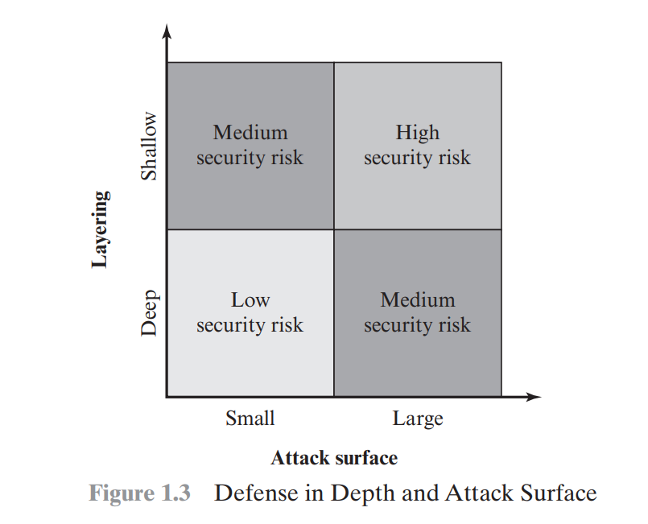
Attack surfaces and attack trees
Layering: This is a network security approach that uses multiple security controls to protect different entryways and aspects of the technology environment from cyberattacks.
The use of layering, or defense in depth, and attack surface reduction complement each other in mitigating security risk in the figure.
Notes:
Layering: This is a network security approach that uses multiple security controls to protect different entryways and aspects of the technology environment from cyberattacks¹.
The purpose of layering is to ensure that each component of the cybersecurity plan has a backup and to make it harder for a hacker to breach the network perimeter¹.

Slide 55
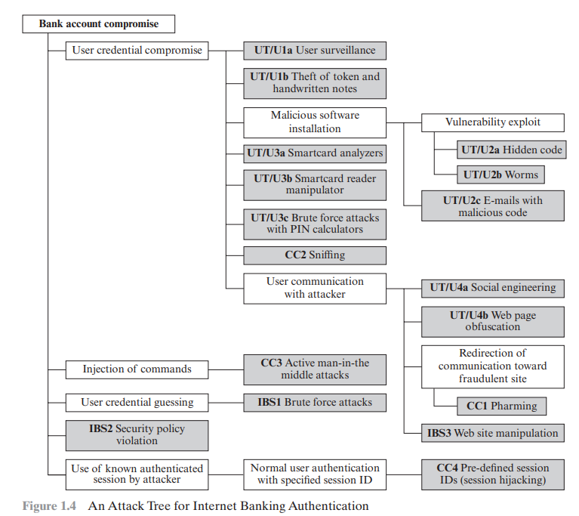
attack trees
Gray is leaf node, events that comprise the attacks
Leaf nodes are OR-nodes here.
Notes:
-objective of the attacker, which is to compromise a user’s account.
-Each node other than a leaf is either an AND-node or an OR-node. To achieve the goal represented by an AND-node, the subgoals represented by all of that node’s subnodes must be achieved. and for an OR-node, at least one of the subgoals must be achieved.
The security incident: is the goal of the attack is represented as the root node of the tree
The analysis to generate this tree considered the three components involved in authentication:
■ User terminal and user (UT/U): These attacks target the user equipment, including the tokens that may be involved, such as smartcards or other password generators, as well as the actions of the user.
■ Communications channel (CC): This type of attack focuses on communication links.
■ Internet banking server (IBS): These types of attacks are offline attacks against the servers that host the Internet banking application.
A pharming attack is a type of cyberattack that tries to redirect you from a legitimate website to a fake one that looks identical. The fake website can capture your confidential information or install malware on your computer. Pharming can be done by changing the host’s file on your computer or by exploiting a vulnerability in the DNS server software. DNS servers are computers that resolve Internet names into their real IP addresses. Pharming is a combination of “phishing” and “farming
pre-defined session IDs :
example, the attacker might send an email to the victim with a link like this:
https://example.com/login.php?sessionID=123456
If the victim clicks on the link, they will be taken to the login page of example.com, but with the session ID set to 123456. When the victim logs in, the server will associate their account with that session ID. The attacker can then use the same link to access the victim’s account without needing their username or password¹.
Another way to perform pre-defined session IDs or session hijacking is to exploit a vulnerability in the server-side application that allows the attacker to set the session ID for any user. For example, the attacker might send a request to the server with a header like this:
Cookie: sessionID=123456
This will tell the server to use 123456 as the session ID for that request. If the attacker can trick the victim into sending such a request, they can fixate their session ID and then hijack their session¹.
Pre-defined session IDs or session hijacking can be prevented by using secure methods of generating and managing session IDs. Some of these methods are:
Use random and unpredictable session IDs that are hard to guess or brute-force.
Use HTTPS protocol to encrypt the communication between the client and the server, and prevent attackers from intercepting or modifying traffic.
Use secure cookies that are marked with flags such as HttpOnly, Secure, and SameSite, which prevent cookies from being accessed or sent by unauthorized parties.
Regenerate session IDs after each successful login or logout, and invalidate old session IDs

Slide 56
The analysis to generate this tree considered the three components involved in authentication:
Five overall attack strategies can be identified, each of which exploits one or more of the three components.
1-User credential compromise: There are procedural attacks, such as monitoring a user’s action to observe a PIN or other credential, or theft of the user’s token or handwritten notes. An adversary may also compromise token information using a variety of token attack tools, such as hacking the smartcard or using a brute force approach to guess the PIN
2-Injection of commands: In this type of attack, the attacker is able to intercept communication between the UT and the IBS.
Notes:
پایانه کاربر و کاربر (UT/U): این حملات تجهیزات کاربر مانند کارت‌های هوشمند یا دیگر تولیدکنندگان رمز عبور را هدف قرار می‌دهند.
کانال ارتباطی (CC): این نوع حمله بر روی پیوندهای ارتباطی متمرکز است
سرور بانکداری اینترنتی (IBS): این نوع حملات حملات آفلاینی علیه سرورهایی هستند که برنامه بانکداری اینترنتی را میزبانی می کنند.
به خطر انداختن اعتبار کاربر: حملات رویه‌ای مانند نظارت بر عملکرد کاربر برای مشاهده پین یا سایر اطلاعات کاربری، یا سرقت نشانه یا یادداشت‌های دست‌نویس کاربر وجود دارد. همچنین ممکن است دشمن با استفاده از انواع ابزارهای حمله توکن، مانند هک کردن کارت هوشمند یا استفاده از رویکرد brute force برای حدس زدن پین، اطلاعات رمز را به خطر بیاندازد.
تزریق دستورات: در این نوع حمله، مهاجم قادر است ارتباط بین UT و IBS را رهگیری کند.

Slide 57
The analysis to generate this tree considered the three components involved in authentication:
3-User credential guessing: brute force attacks against some banking authentication schemes are feasible by sending random usernames and passwords. The attack mechanism is based on distributed zombie personal computers, hosting automated programs for username- or password-based calculation.
4-Security policy violation: For example, violating the bank’s security policy in combination with weak access control and logging mechanisms, an employee may cause an internal security incident and expose a customer’s account.
5- Use of known authenticated session : This type of attack persuades or forces the user to connect to the IBS with a preset session ID. Once the user authenticates to the server, the attacker may utilize the known session ID to send packets to the IBS, spoofing the user’s identity.
Notes:
. ■ استفاده از جلسه احراز هویت شناخته شده: این نوع حمله کاربر را متقاعد یا مجبور می کند تا با یک شناسه جلسه از پیش تعیین شده به IBS متصل شود. هنگامی که کاربر به سرور احراز هویت می شود، مهاجم ممکن است از شناسه جلسه شناخته شده برای ارسال بسته ها به IBS استفاده کند و هویت کاربر را جعل کند.

Slide 58
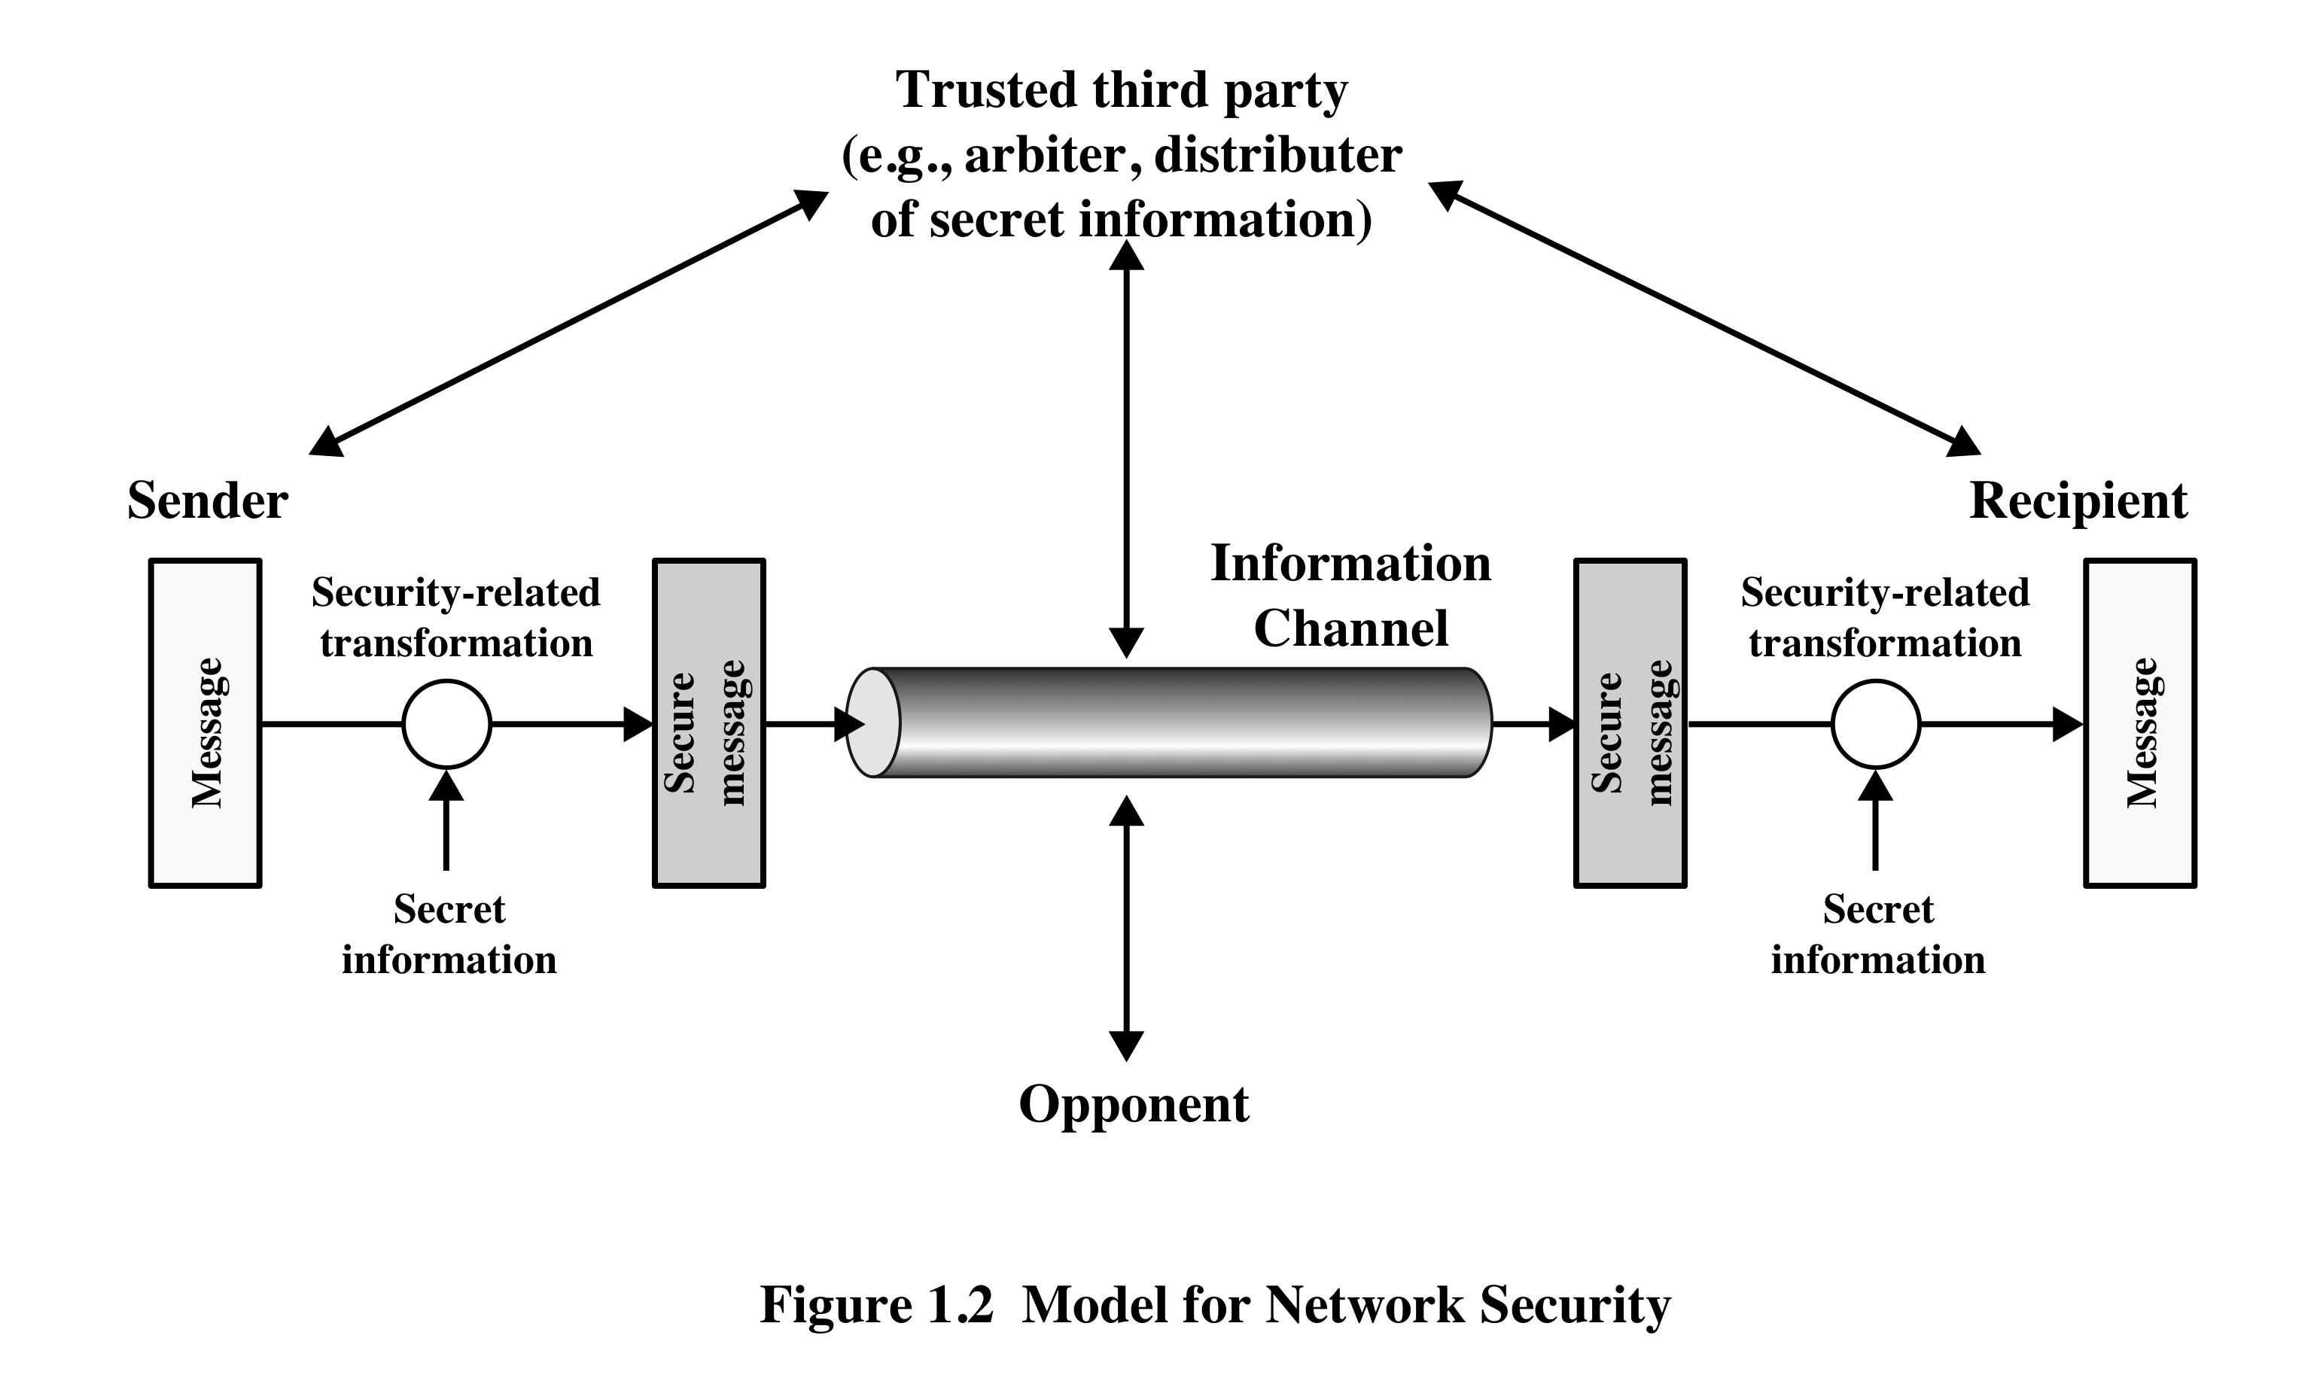
Model for Network Security
A trusted third party may be needed to achieve secure transmission. For example, a third party may be responsible for distributing the secret information to the two principals while keeping it from any opponent.
Notes:
مدلی برای بسیاری از مواردی که در مورد آن بحث خواهیم کرد، قرار است یک پیام از یک طرف به طرف دیگر از طریق برخی منتقل شود
یک کانال اطلاعات منطقی با تعریف مسیری از طریق اینترنت از مبدا تا مقصد ایجاد می شود
و با استفاده مشترک از پروتکل های ارتباطی (به عنوان مثال، TCP/IP) توسط دو مدیر.
جنبه‌های امنیتی زمانی وارد عمل می‌شوند که محافظت از انتقال اطلاعات در برابر حریفی که ممکن است محرمانه بودن را تهدید کند، ضروری یا مطلوب باشد.
اصالت و غیره تمامی تکنیک های تامین امنیت دو جزء دارند:
1. تحول مرتبط با امنیت در اطلاعاتی که باید ارسال شود. به عنوان مثال می توان به رمزگذاری پیام اشاره کرد که پیام را به گونه ای درهم می کند که توسط حریف قابل خواندن نباشد و افزودن کدی بر اساس محتوای پیام که می تواند برای تأیید هویت فرستنده استفاده شود.
2. برخی از اطلاعات محرمانه به اشتراک گذاشته شده توسط دو مدیر و امید است که برای حریف ناشناخته باشد. یک مثال، یک کلید رمزگذاری است که همراه با تبدیل برای درهم کردن پیام قبل از ارسال و باز کردن آن در هنگام دریافت استفاده می شود.
ممکن است برای دستیابی به انتقال ایمن به یک شخص ثالث قابل اعتماد نیاز باشد. برای مثال، شخص ثالثی ممکن است مسئول توزیع اطلاعات محرمانه به دو مدیر اصلی باشد و در عین حال از هر مخالفی محافظت کند. یا ممکن است شخص ثالثی برای داوری اختلافات بین دو رئیس در مورد اصالت مورد نیاز باشد
از یک انتقال پیام
A model for much of what we will be discussing is captured, in very general terms, in Figure 1.2. A message is to be transferred from one party to another across some
sort of Internet service. The two parties, who are the principals in this transaction,must cooperate for the exchange to take place. A logical information channel is established by defining a route through the Internet from source to destinationand by the coope rative use of communication protocols (e.g., TCP/IP) by the two principals.
Security aspects come into play when it is necessary or desirable to protect the information transmission from an opponent who may present a threat to confidentiality,
authenticity, and so on. All of the techniques for providing security have two components:
1. A security-related transformation on the information to be sent. Examples
include the encryption of the message, which scrambles the message so that it
is unreadable by the opponent, and the addition of a code based on the contents
of the message, which can be used to verify the identity of the sender.
2. Some secret information shared by the two principals and, it is hoped,
unknown to the opponent. An example is an encryption key used in conjunction
with the transformation to scramble the message before transmission and
unscramble it on reception.
A trusted third party may be needed to achieve secure transmission. For
example, a third party may be responsible for distributing the secret information
to the two principals while keeping it from any opponent. Or a third party may be
needed to arbitrate disputes between the two principals concerning the authenticity
of a message transmission.

Slide 59
four basic tasks in designing a particular security service
This general model shows that there are four basic tasks in designing a particular security service
1. Design an algorithm for performing the security-related transformation. The algorithm should be such that an opponent cannot defeat its purpose.
2. Generate the secret information to be used with the algorithm.
3. Develop methods for the distribution and sharing of the secret information.
4. Specify a protocol to be used by the two principals that make use of the security algorithm and the secret information to achieve a particular security service.
Notes:
Parts One and Two of this book concentrate on the types of security mechanisms
and services that fit into the model shown in Figure 1.2. However, there are
other security-related situations of interest that do not neatly fit this model but are
considered in this book.

Slide 60
Hacker vs intruder
The hacker can be someone who, with no malign intent, simply gets satisfaction from breaking and entering a computer system.
The intruder can be a disgruntled employee who wishes to do damage or a criminal who seeks to exploit computer assets for financial gain
Notes:
-هکر می تواند کسی باشد که بدون قصد بد، به سادگی از شکستن و ورود به یک سیستم کامپیوتری رضایت داشته باشد.
-مزاحم می تواند یک کارمند ناراضی باشد که می خواهد خسارت وارد کند یا یک مجرم که به دنبال سوء استفاده از دارایی های رایانه ای برای منافع مالی است (به عنوان مثال، به دست آوردن شماره کارت اعتباری یا انجام غیرقانونی).
انتقال پول).

Slide 61
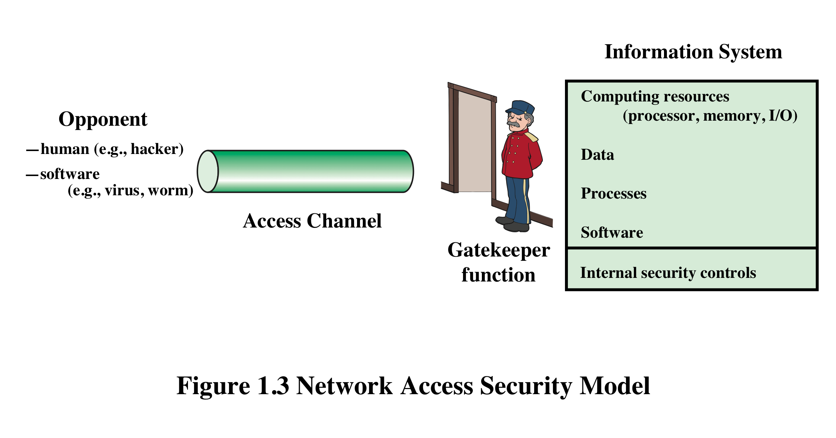
Network Access Security Model
Notes:
یک مدل کلی از این موقعیت های دیگر توسط نشان داده شده است
شکل 1.3، که نشان دهنده نگرانی برای محافظت از یک سیستم اطلاعاتی از دسترسی ناخواسته است. اکثر خوانندگان با نگرانی های ناشی از وجود هکرهایی که سعی در نفوذ به سیستم هایی دارند که از طریق شبکه قابل دسترسی هستند آشنا هستند.
ویروس و کرم هر دو اشکال بدافزار هستند، اما رفتار آنها متفاوت است:
ویروس کامپیوتری:
ویروس یک کد اجرایی مخرب است که به فایل اجرایی دیگری متصل شده است که می تواند بی ضرر باشد یا می تواند داده ها را تغییر داده یا حذف کند.
برای گسترش به میزبان نیاز دارد. این ویروس تا زمانی که شما به طور ناخواسته با اجرای فایل آلوده آن را فعال نکنید، غیر فعال است.
ویروس‌ها می‌توانند انواع مختلفی از آسیب‌ها را ایجاد کنند، مانند خراب کردن فایل‌ها یا برنامه‌ها، آسیب رساندن به عملکرد رایانه و آلوده کردن دستگاه‌های بیشتر و بیشتر.
نمونه ای از ویروس ها ویروس ILOVEYOU است که از طریق پیوست های ایمیل پخش می شود.
کرم کامپیوتری:
کرم نوعی بدافزار است که خود را تکثیر می کند و می تواند از طریق شبکه به رایانه های مختلف سرایت کند.
برخلاف ویروس ها، کرم ها می توانند بدون هیچ گونه فعالیت انسانی تکثیر و پخش شوند.
هدف اصلی کرم ها خوردن منابع سیستم است. منابع سیستم مانند حافظه و پهنای باند را مصرف می کند و سرعت سیستم را به حدی کاهش می دهد که دیگر پاسخ نمی دهد.
نمونه‌ای از کرم‌ها، کرم باج‌افزار WannaCry است که از بلوک پیام سرور ویندوز (SMBv1)، یک پروتکل اشتراک‌گذاری منابع، سوء استفاده می‌کند.
به طور خلاصه، تفاوت اصلی بین ویروس و کرم در این است که ویروس ها باید توسط تعامل میزبان/قربانی آنها با فایل آلوده فعال شوند. در مقابل، کرم‌ها برنامه‌های مخرب مستقلی هستند که می‌توانند به‌محض نفوذ به سیستم، به‌طور مستقل تکثیر و منتشر شوند.

Slide 62
Unwanted Access
Placement of logic in a computer system that exploits vulnerabilities in the system and that can affect application programs as well as utility programs
Programs can present two kinds of threats:
Information access threats
Intercept or modify data on behalf of users who should not have access to that data
Service threats
Exploit service flaws in computers to inhibit use by legitimate users
Notes:
نوع دیگر دسترسی ناخواسته، قرار دادن در یک سیستم کامپیوتری منطقی است که از آسیب پذیری های سیستم سوء استفاده می کند و می تواند بر برنامه های کاربردی و همچنین برنامه های کاربردی مانند ویرایشگرها و کامپایلرها تأثیر بگذارد. برنامه ها می توانند دو نوع تهدید ایجاد کنند:
1. تهدیدات دسترسی به اطلاعات: رهگیری یا اصلاح داده ها از طرف کاربرانی که نباید به آن داده ها دسترسی داشته باشند.
2. تهدیدات سرویس: از نقص های سرویس در رایانه ها برای جلوگیری از استفاده توسط کاربران قانونی سوء استفاده کنید.
ویروس ها و کرم ها دو نمونه از حملات نرم افزاری هستند. چنین حملاتی را می توان با استفاده از دیسکی وارد سیستم کرد که حاوی منطق ناخواسته پنهان در نرم افزارهای مفید دیگری است. آنها همچنین می توانند در یک سیستم در سراسر یک شبکه درج شوند. این مکانیسم اخیر در امنیت شبکه بیشتر مورد توجه است.
مکانیسم های امنیتی مورد نیاز برای مقابله با دسترسی ناخواسته به دو دسته کلی تقسیم می شوند (شکل 1.3 را ببینید). دسته اول را می توان عملکرد دروازه بان نامید. این شامل رویه‌های ورود مبتنی بر رمز عبور است که برای ممانعت از دسترسی به همه کاربران غیر مجاز و منطق غربالگری طراحی شده است که برای شناسایی طراحی شده است.
و کرم ها، ویروس ها و سایر حملات مشابه را رد کنید. هنگامی که یک کاربر ناخواسته یا نرم افزار ناخواسته دسترسی پیدا می کند، خط دوم دفاعی شامل انواع کنترل های داخلی است که فعالیت ها را نظارت می کند و اطلاعات ذخیره شده را در تلاش برای شناسایی حضور مزاحمان ناخواسته تجزیه و تحلیل می کند. این مسائل در بخش سوم بررسی شده است.
Another type of unwanted access is the placement in a computer system
of logic that exploits vulnerabilities in the system and that can affect application
programs as well as utility programs, such as editors and compilers. Programs can
present two kinds of threats:
1. Information access threats: Intercept or modify data on behalf of users who
should not have access to that data.
2. Service threats: Exploit service flaws in computers to inhibit use by legitimate
users.
Viruses and worms are two examples of software attacks. Such attacks can be
introduced into a system by means of a disk that contains the unwanted logic concealed
in otherwise useful software. They also can be inserted into a system across a
network; this latter mechanism is of more concern in network security.
The security mechanisms needed to cope with unwanted access fall into two
broad categories (see Figure 1.3). The first category might be termed a gatekeeper
function. It includes password-based login procedures that are designed to deny
access to all but authorized users and screening logic that is designed to detect
and reject worms, viruses, and other similar attacks. Once either an unwanted user
or unwanted software gains access, the second line of defense consists of a variety
of internal controls that monitor activity and analyze stored information in an
attempt to detect the presence of unwanted intruders. These issues are explored in
Part Three.

Slide 63
standards
Many of the security techniques and applications described in this book have been specified as standards. Important organizations that involved in development of these standards are as follows.
NIST
ISOC
National Institute of Standards and Technology
It is a U.S. federal agency that deals with measurement science, standards, and technology related to U.S. government use and to the promotion of U.S. private-sector innovation
NIST Federal Information Processing Standards (FIPS) and Special Publications (SP) have a worldwide impact
Internet Society
Professional membership society with worldwide organizational and individual membership
Provides leadership in addressing issues that confront the future of the Internet
Is the organization home for the groups responsible for Internet infrastructure standards, including the Internet Engineering Task Force (IETF) and the Internet Architecture Board (IAB)
Internet standards and related specifications are published as Requests for Comments (RFCs)
Notes:
بسیاری از تکنیک ها و کاربردهای امنیتی که در این کتاب توضیح داده شده است به عنوان استاندارد مشخص شده اند. علاوه بر این، استانداردهایی برای پوشش شیوه های مدیریت و معماری کلی مکانیسم ها و خدمات امنیتی ایجاد شده است. در سراسر این کتاب، ما مهمترین استانداردهای مورد استفاده را شرح می دهیم
یا در حال توسعه برای جنبه های مختلف رمزنگاری و امنیت شبکه است.
سازمان های مختلفی در توسعه یا ارتقای این استانداردها مشارکت داشته اند. مهمترین (در شرایط فعلی) این سازمانها به شرح زیر است.
• موسسه ملی استانداردها و فناوری: NIST یک آژانس فدرال ایالات متحده است که با علم اندازه گیری، استانداردها و فناوری مربوط به استفاده دولت ایالات متحده و ارتقاء نوآوری بخش خصوصی ایالات متحده سر و کار دارد.
با وجود دامنه ملی آن، استانداردهای پردازش اطلاعات فدرال NIST (FIPS) و انتشارات ویژه (SP) تأثیری جهانی دارند.
• جامعه اینترنتی: ISOC یک انجمن عضویت حرفه ای با عضویت سازمانی و فردی در سراسر جهان است. این سازمان رهبری را در رسیدگی به مسائلی که با آینده اینترنت مواجه است فراهم می کند و محل سازمانی برای گروه های مسئول استانداردهای زیرساخت اینترنت، از جمله کارگروه مهندسی اینترنت (IETF) و هیئت معماری اینترنت (IAB) است. این سازمان‌ها استانداردهای اینترنتی و مشخصات مرتبط را توسعه می‌دهند که همگی به‌عنوان درخواست‌های نظرات (RFC) منتشر می‌شوند.
بحث مفصل تر در مورد این سازمان ها در ضمیمه C آمده است.

Slide 64
Summary
Computer security concepts
Definition
Examples
Challenges
The OSI security architecture
Security attacks
Passive attacks
Active attacks
Security services
Authentication
Access control
Data confidentiality
Data integrity
Nonrepudiation
Availability service
Security mechanisms
Model for network security
Standards
Notes:
مفاهیم امنیت کامپیوتر
تعریف
مثال ها
چالش ها
معماری امنیتی OSI
حملات امنیتی
حملات غیر فعال
حملات فعال

Slide 65
Solve your problem
How to calculate your assigned problem.
P=((id -1 ) mod N) +1
E.X.,
If there were three problems (N=3) and your group id is 1 or A then you need to solve problem 1. (1-1 % 3)+1==1
If your group id were 3 then (3-1) %3+1== 3
Or your group id were 4 then your need to solve (4-1)%3+1==1

Slide 66
Problems 1
Consider an automated teller machine (ATM) in which users provide a personal identification number (PIN) and a card for account access. Give examples of confidentiality, integrity, and availability requirements associated with the system. In each case, indicate the degree of importance of the requirement.
یک دستگاه باجه خودکار (ATM) را در نظر بگیرید که در آن کاربران یک شماره شناسایی شخصی (PIN) و یک کارت برای دسترسی به حساب ارائه می کنند. مثال هایی از محرمانه بودن، یکپارچگی، و الزامات در دسترس بودن مرتبط با سیستم را ذکر کنید. در هر مورد، درجه اهمیت مورد نیاز را مشخص کنید.
Notes:
Answer:

Slide 67
Problems 2
For a telephone switching system that routes calls through a switching network based on the telephone number requested by the caller. Give examples of confidentiality, integrity, and availability requirements associated with the system. In each case, indicate the degree of importance of the requirement.
برای یک سیستم سوئیچینگ تلفن که تماس ها را از طریق یک شبکه سوئیچینگ بر اساس شماره تلفن درخواست شده توسط تماس گیرنده هدایت می کند. مثال هایی از محرمانه بودن، یکپارچگی، و الزامات در دسترس بودن مرتبط با سیستم را ذکر کنید. در هر مورد، درجه اهمیت مورد نیاز را مشخص کنید.
Notes:
Answer:

Slide 68
Problem 3
For each of the following assets, assign a low, moderate, or high impact level for the loss of confidentiality, availability, and integrity, respectively. Justify your answers.
a. A portal maintained by the Government to provide information regarding its departments and services.
b. A hospital managing the medical records of its patients.
c. A financial organization managing routine administrative information (not privacy-related information).
d. An information system used for large acquisitions in a contracting organization that contains both sensitive, pre-solicitation phase contract information and routine administrative information. Assess the impact for the two data sets separately and the information system as a whole.
e. The Examinations department of a University maintains examination particulars, such as question papers of forthcoming examinations, grades obtained, and examiner details. The University’s administrative department maintains the students’ attendance particulars and internal assessment results. Assess the impact for the two data sets separately and the information system as a whole

Slide 69
۳ مسئله
برای هر یک از موضوعات زیر، به ترتیب یک سطح تاثیر کم، متوسط یا زیاد برای از دست دادن محرمانگی، دسترسی و یکپارچگی تعیین کنید. پاسخ های خود را توجیه کنید.
الف-. درگاهی که توسط دولت برای نمایش اطلاعات مربوط به بخش ها و خدمات خود نگهداری می شود.
ب- بیمارستانی که پرونده های پزشکی بیماران خود را مدیریت می کند.
ج. یک سازمان مالی که اطلاعات اداری معمول را مدیریت می کند (نه اطلاعات مربوط به حریم خصوصی).
د- یک سیستم اطلاعاتی که برای خریدهای بزرگ در یک سازمان پیمانکاری استفاده می‌شود که شامل اطلاعات حساس قرارداد مرحله قبل از درخواست و اطلاعات اداری معمول است. تأثیر دو مجموعه داده را به طور جداگانه و سیستم اطلاعاتی را به عنوان یک کل ارزیابی کنید.
ه. بخش امتحانات یک دانشگاه اطلاعات امتحانی، مانند برگه سوالات امتحانات آینده، نمرات کسب شده و جزئیات امتحان را حفظ می کند. بخش اداری دانشگاه اطلاعات حضور و غیاب دانشجویان و نتایج ارزیابی داخلی را حفظ می کند. تأثیر دو مجموعه داده را به طور جداگانه و سیستم اطلاعاتی را به عنوان یک کل ارزیابی کنید.

Slide 70
Answer
Answer A: Confidentiality, integrity, and availability (CIA) are three fundamental aspects of information security in any system, including an automated teller machine (ATM). Let's explore examples of each requirement and their degree of importance:
Confidentiality: Confidentiality ensures that sensitive information is only accessible to authorized individuals or entities. In the context of an ATM system: Example: Personal Identification Number (PIN) protection
Requirement: The ATM system must ensure that the PIN entered by the user remains confidential and is not disclosed to anyone unauthorized. Importance: High. This is crucial because unauthorized access to a user's PIN could lead to unauthorized account access and potential financial loss.
Integrity: Integrity ensures that data remains accurate and unaltered during storage, processing, and transmission.
Example: Transaction data integrity. Requirement: The ATM system must guarantee that the transaction data, such as withdrawal amount and account balance, remain accurate and unaltered throughout the transaction process.
Importance: High. Any tampering with transaction data could result in financial discrepancies and erode trust in the ATM system.
Availability:Availability ensures that the system and its resources are accessible and operational when needed.
Example: ATM uptime and availability. Requirement: The ATM system must be available for use by customers at all times, except during scheduled maintenance or unforeseen technical issues. Importance: High. ATMs are critical infrastructure for customers to access their funds and conduct financial transactions. Downtime can inconvenience users and may lead to dissatisfaction.
The confidentiality of sensitive data, such as PINs, is usually given utmost importance, followed closely by data integrity and system availability. Organizations must implement robust security measures and redundancy to address these requirements effectively and ensure a secure and reliable ATM system.

Slide 71
Answer C
a. Government Portal: Confidentiality: Low. The information is intended for public viewing, so loss of confidentiality has a low impact.
Availability: High. The public and various entities rely on this information, so its unavailability can have a high impact.
Integrity: Moderate. While the information is public, any unauthorized changes can cause misinformation.
b. Hospital Medical Records:
Confidentiality: High. Medical records contain sensitive patient information. Unauthorized access can lead to serious privacy violations.
Availability: High. Healthcare providers need immediate access to these records to provide effective care.
Integrity: High. Unauthorized changes can lead to misdiagnosis or incorrect treatment.

